Slide 1





Dance Presentation
DANCE
"Dance is the hidden language of the soul."
Start
#dancenow

Slide 2
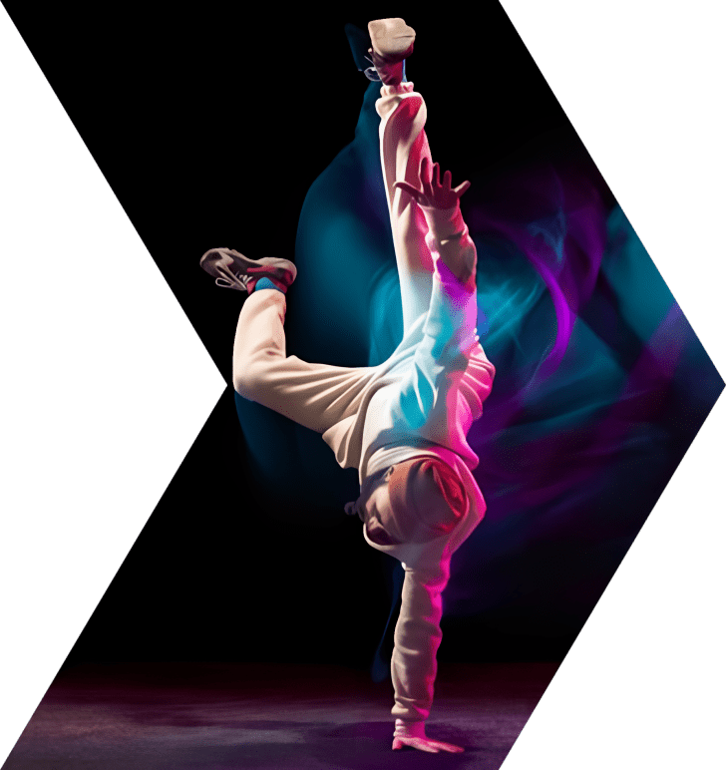
Dance As A Form Of Expression
Explore how dance serves as a powerful means of self-expression, allowing individuals to communicate emotions, tell stories, and convey messages through movement.

Slide 3
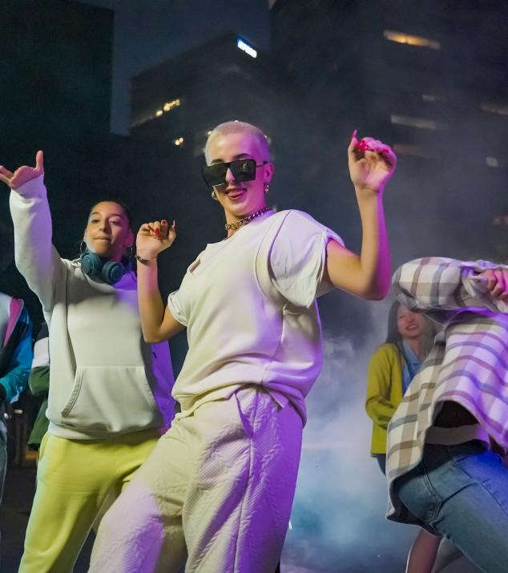
Dance And Cultural Identity
Investigate how various dance forms are deeply rooted in cultural traditions and play a significant role in preserving and celebrating a community's heritage, values, and customs.

Slide 4
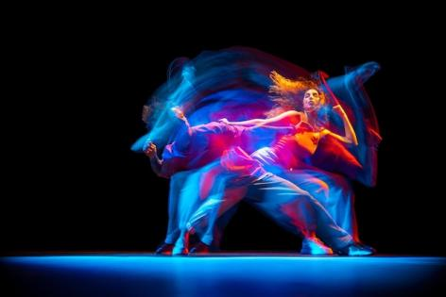

Dance As A Physical Fitness Activity
Discover how engaging in dance can provide a fun and effective way to stay fit, improve cardiovascular health, enhance flexibility, and strengthen muscles while enjoying rhythmic movement.

Slide 5

Dance and Social
Connection
Highlight the social aspect of dance, as it brings people together, fosters teamwork and cooperation, and creates a sense of belonging and camaraderie within dance communities.

Slide 6

Dance and Mental Well-being
Examine the positive impact of dance on mental health, such as reducing stress, boosting mood, enhancing self-confidence, and promoting mindfulness and body awareness.

Slide 7

Dance In Education
Discuss the inclusion of dance in educational settings, exploring its role in promoting creativity, discipline, self-expression, and fostering holistic development in students.

Slide 8
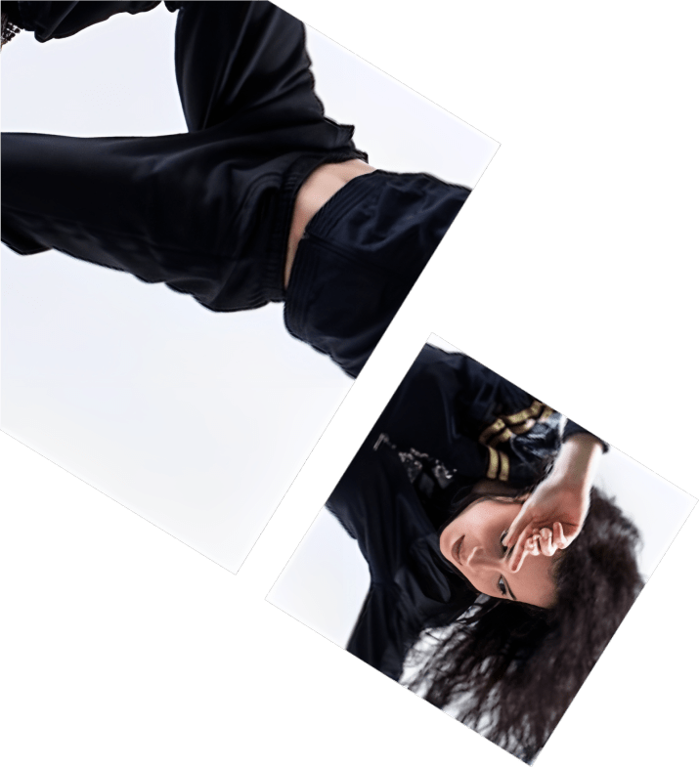
Dance And Gender Roles
Explore how dance challenges or reinforces traditional gender roles, examining the evolution of gender representation in dance and its impact on societal perceptions.

Slide 9

Dance Therapy
Delve into the therapeutic benefits of dance, including its use as a form of rehabilitation, self-discovery, and healing for individuals dealing with physical, emotional, or psychological challenges.

Slide 10

Dance and Technology
Investigate the integration of technology in dance performances, discussing innovative techniques like motion capture, projection mapping, or virtual reality in enhancing artistic expressions.

Slide 11

Dance In Popular Culture
Examine the influence of dance in mainstream media, analyzing its portrayal in music videos, films, and television shows, and its impact on shaping contemporary trends and styles.

Slide 12

Dance Competitions
Explore the world of dance competitions, discussing their role in showcasing talent, fostering healthy competition, and providing opportunities for dancers to gain recognition and exposure.

Slide 13

Dance As A Career
Highlight the diverse career paths in dance, ranging from professional dancers and choreographers to dance educators, dance therapists, artistic directors, and dance company administrators.

Slide 14
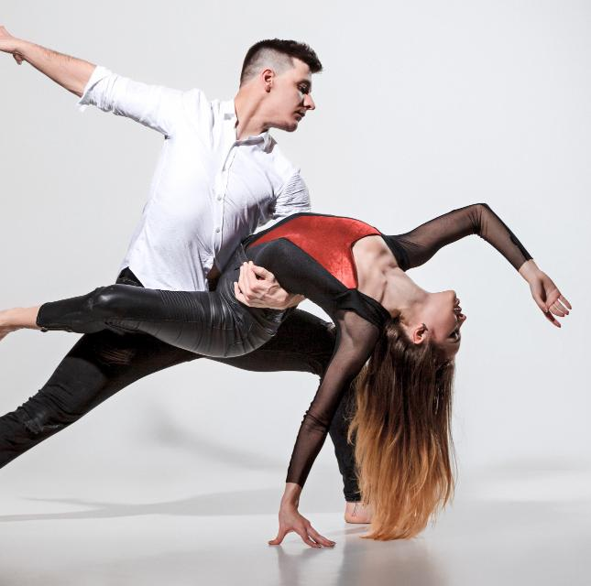
Dance and Historical Movements
Investigate how dance has been intertwined with significant historical movements, such as the civil rights movement, feminist movement, or LGBTQ+ activism, serving as a form of protest, liberation, and cultural resistance.

Slide 15
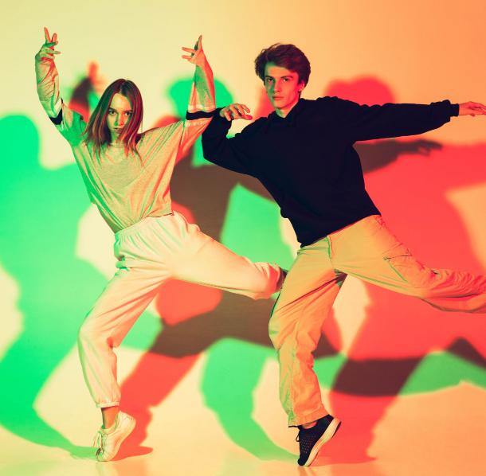
Dance And Fashion
Discuss the interplay between dance and fashion, exploring how costume design and aesthetics enhance performances, reflect cultural influences, and contribute to the visual storytelling of dance.

Slide 16
Icons

Slide 17
Icons

Slide 18
How To Edit Shapes
You can add and edit some shapes to your presentation to present your data in a visual way.
Choose your favourite infographic and insert it in your presentation using Ctrl C + Ctrl V or Cmd C + Cmd V in Mac.
Select one of the parts and ungroup it by right-clicking and choosing “Ungroup”.
Change the color by clicking on the paint bucket.
Then resize the element by clicking and dragging one of the square-shaped points of its bounding box (the cursor should look like a double-headed arrow). Remember to hold Shift while dragging to keep the proportions.
Group the elements again by selecting them, right-clicking and choosing “Group”.
Repeat the steps above with the other parts and when you’re done editing, copy the end result and paste it into your presentation.
Remember to choose the “Keep source formatting” option so that it keeps the design. For more info, please visit italkedtech (Tips & Tricks).

Slide 19
Terms Of Use (Free Users)
If you are a free subscriber, you should credit italkedtech by keeping the “Thank You” slide.
Kindly refer to the following slide for the Terms of Use for premium users.
You can:
Customize or edit this template
Use this template for both business and personal endeavors.
You can not:
Sell, rent, or second-license italkedtech content or its altered version.
Promulgate, unless explicitly permitted, italkedtech content, by italkedtech.
Incorporate italkedtech content in any database or file online or offline.
Obtain italkedtech content’s copyright.
Kindly refer to our Tutorial page or FAQ for advanced slide modification guidelines.

Slide 20
Terms Of Use (Premium Users)
Being a premium subscriber, you have the privilege of using this PPT template
without giving attribution to italkedtech or keeping the “Thank You” slide.
You can:
Customize or edit this template.
Use this template for both business and personal endeavors.
Circulate or share the editable format of this template with anyone you want.
You can not:
Sell, rent or second-license italkedtech content or the altered version of it.
Promulgate or include the templates in any other services database
that performs as distribution or resale platform, unless explicitly permitted, by italkedtech.
Incorporate the elements used in italkedtech’s templates separately.
Obtain italkedtech’s copyright for the elements used in this template as a logo or trademark.
Kindly refer to our Tutorial page or FAQ for advanced slide modification guidelines.

Slide 21



Thank You!
We respect your valuable time with italkedtech!
If you have any questions, please reach us
,
Do you have a design request, please visit our redesign page.
CREDIT: italkedtech created this PowerPoint template.
Let this slide be kept for attribution.
www.italkedtech.com

