Slide 1

World Day For Safety And Health At Work
April 28

Slide 2

Table Of Contents
1
Introduction
2
Facts
3
Symbol
4
Conclusion

Slide 3

1
Introduction

Slide 4

Introduction
World Day for Safety and Health at Work is an annual international observance that takes place on April 28th. The day is dedicated to promoting safe and healthy work environments, as well as raising awareness about the importance of occupational safety and health. The World Day for Safety and Health at Work was first observed in 2003 by the International Labour Organization (ILO) and has since become an important date on the calendar for workers, employers, and governments worldwide.

Slide 5


Activities
Conduct Safety Training:
Employers can organize safety training sessions for their employees to promote a safe and healthy work environment. These sessions can cover topics such as proper use of equipment, emergency procedures, and workplace ergonomics.
Workplace Safety Inspections:
Employers can conduct workplace safety inspections to identify and address potential hazards in the workplace. This can include inspecting equipment, ensuring proper storage of materials, and identifying any other hazards that could pose a risk to employee safety.
Ultimately, the goal of World Day for Safety and Health at Work is to promote safe and healthy work environments for all workers. By organizing activities and initiatives that promote workplace safety and health, employers can help to prevent accidents, injuries, and illnesses, and create a more productive and sustainable work environment.

Slide 6
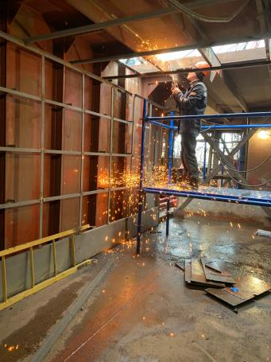

Health and Wellness Initiatives:
Employers can organize health and wellness initiatives to promote healthy lifestyles and mental health among employees. This can include providing healthy snacks, offering gym memberships, or organizing stress-reduction workshops.
Awareness Campaigns:
Employers can raise awareness about occupational safety and health issues by organizing campaigns in the workplace. This can include posters, brochures, and other materials that highlight the importance of workplace safety and health.
Activities

Slide 7

Promotes awareness:
World Day for Safety and Health at Work raises awareness about the importance of occupational safety and health, and helps to bring attention to the human, social and economic costs of workplace accidents and illnesses.
Encourages action:
The day encourages employers, workers, and governments to take action to promote safe and healthy work environments, and to prevent accidents and illnesses in the workplace.
Celebrates success:
World Day for Safety and Health at Work provides an opportunity to celebrate successes in occupational safety and health programs, and to acknowledge the achievements of individuals and organizations that have worked hard to promote a safe and healthy work environment.
Why We Love

Slide 8


Creates more productive economies
Why We Love
World Day for Safety and Health at Work is an important date on the calendar for workers, employers, and governments worldwide. It provides an opportunity to promote safe and healthy work environments, and to raise awareness about the importance of occupational safety and health. By working together to promote workplace safety and health, we can create a safer, healthier, and more productive world for all.
Improves workplace culture
By promoting a culture of safety and health in the workplace, World Day for Safety and Health at Work helps to create a more positive work environment, where workers feel valued and protected.
Safe and healthy workers are more productive, and by promoting workplace safety and health, World Day for Safety and Health at Work helps to create more productive and sustainable economies.

Slide 9


Protects workers: A safe and healthy work environment protects workers from injury, illness, and even death. Workers who feel safe and secure are more likely to be productive and satisfied with their jobs.
Prevents accidents: Occupational safety and health programs can help prevent workplace accidents and incidents, which not only protects workers but also minimizes the risk of property damage and financial loss for the employer.
Reduces absenteeism and turnover: A safe and healthy work environment can reduce absenteeism and turnover rates as workers are more likely to feel valued and satisfied with their jobs.
Importance

Slide 10

4. Enhances reputation
Companies that prioritize safety and health at work are seen as responsible and reliable. This can help enhance the company's reputation, attract and retain top talent, and increase customer loyalty.
5. Complies with regulations
Safety and health regulations are in place to protect workers and ensure that employers are held accountable for providing a safe work environment. Compliance with these regulations helps to minimize the risk of legal action and financial penalties.

Slide 11

Safety and Health at Work in the 21st Century
The 21st century has seen a number of changes in the workplace, particularly in terms of technology and the way we work.
As a result, workplace safety and health has become an increasingly important issue.
It is essential that employers, workers, governments, and society as a whole take steps to ensure that workplaces are safe and healthy.
World Day for Safety and Health at Work is a reminder of the importance of this issue.

Slide 12

The Role Of Governments In Promoting Safety And Health At Work
Developing and enforcing safety regulations
Governments can create regulations that ensure the safety of workers in different industries.
1
Providing training and education
Governments can offer training and education programs to workers and employers on safety and health issues.
2
Conducting inspections
Governments can conduct regular inspections to identify potential hazards and violations of safety regulations.
3

Slide 13

Conducting regular safety training
Employers can provide regular safety training to employees to help them understand the potential hazards associated with their jobs and how to prevent accidents and injuries. This training can include emergency preparedness, first aid, and proper use of equipment..
4
5
Developing and implementing safety policies
Employers can create and implement safety policies that outline the procedures and rules for maintaining a safe and healthy working environment. These policies should be communicated to all employees and enforced consistently.

Slide 14
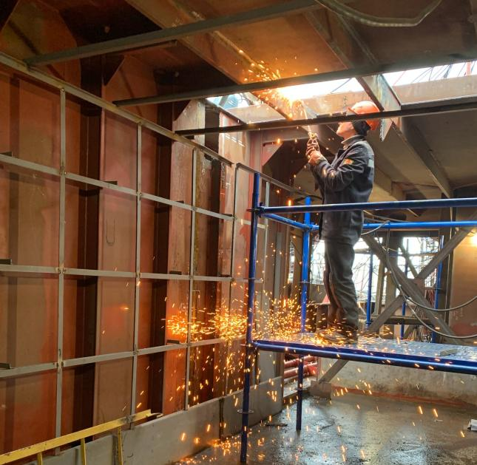
2
Facts

Slide 15

The event is recognized by the United Nations
World Day for Safety and Health at Work is recognized by the United Nations and is also observed by many organizations and governments around the world.
The theme changes every year
Each year, a theme is selected to highlight different aspects of workplace safety and health. For example, the theme for 2020 was "Stop the Pandemic: Safety and Health at Work Can Save Lives", while the theme for 2021 was "Anticipate, prepare and respond to crises - Invest now in resilient occupational safety and health systems".
Facts

Slide 16



Identifying and addressing hazards
Employers should identify potential hazards in the workplace and take steps to mitigate or eliminate them. This could involve modifying equipment, implementing safety measures, or providing personal protective equipment (PPE).

Slide 17

"The tragedy of life is not that it ends so soon, but that we wait so long to begin it."

Slide 18


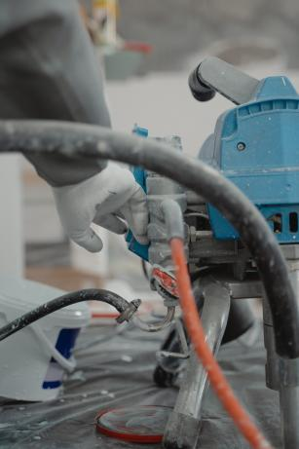
It is an opportunity to raise awareness
World Day for Safety and Health at Work provides an opportunity to raise awareness about workplace safety and health issues, as well as to promote the implementation of policies and practices that protect workers.
It highlights the human cost of workplace accidents and diseases
Every year, millions of workers are injured or killed as a result of workplace accidents or illnesses.

Slide 19
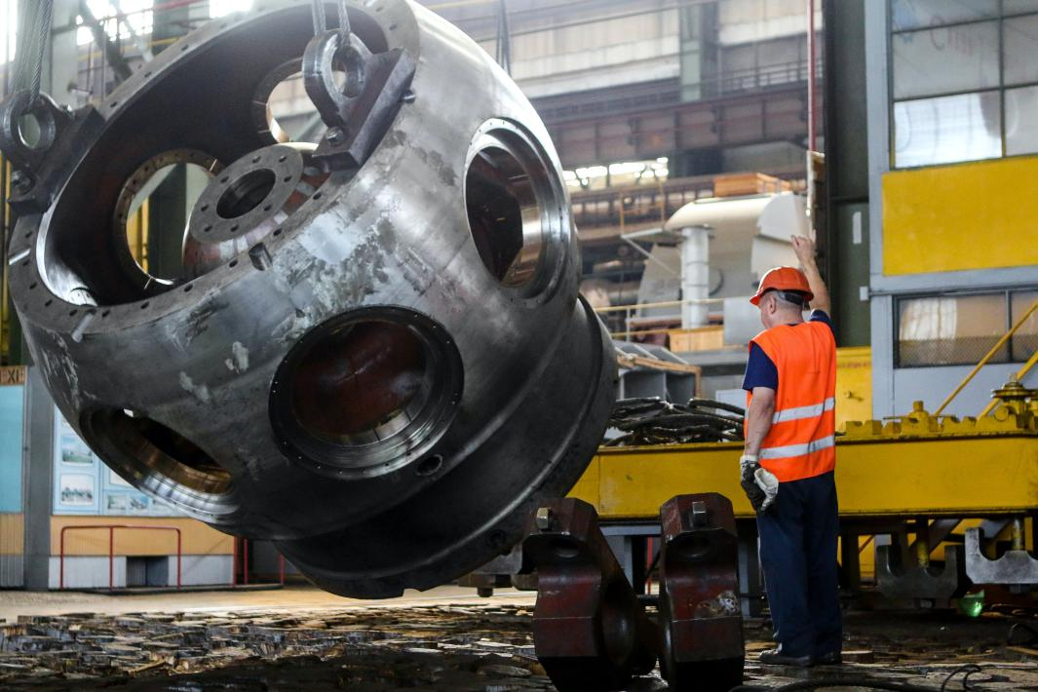
3
Symbol

Slide 20

Symbol
The symbol of World Day for Safety and Health at Work is a green and yellow "safety helmet". This symbol represents the importance of protective equipment and safety measures in the workplace, as well as the need to prioritize worker safety and health. The green and yellow colors of the helmet are often associated with safety and caution, and serve as a reminder of the importance of promoting safe work practices and preventing accidents and injuries. The symbol is used by organizations and governments around the world to raise awareness about workplace safety and health issues on April 28th each year.
Symbol

Slide 21

FAQs
Who observes World Day for Safety and Health at Work?
World Day for Safety and Health at Work is observed by many organizations and governments around the world, as well as the United Nations.
What is the theme for World Day for Safety and Health at Work?
The theme for World Day for Safety and Health at Work changes every year. For example, the theme for 2021 was "Anticipate, prepare and respond to crises - Invest now in resilient occupational safety and health systems".
How can I participate in World Day for Safety and Health at Work?
You can participate in World Day for Safety and Health at Work by raising awareness about workplace safety and health issues, promoting safe work practices, and advocating for policies that protect workers.

Slide 22

Tradition
World Day for Safety and Health at Work does not have a specific traditional celebration or observance, but it is typically marked by events and activities organized by governments, organizations, and businesses around the world to promote workplace safety and health. These events can include safety training, educational seminars, workshops, and awareness campaigns. In some countries, there may also be parades, marches, or demonstrations to raise awareness about workplace safety and health issues. Overall, the tradition of World Day for Safety and Health at Work is to emphasize the importance of worker safety and health, and to promote policies and practices that prevent workplace accidents and illnesses.

Slide 23
Dates
Year | Date | Day
2023 | April 28 | Friday
2024 | April 28 | Sunday
2025 | April 28 | Monday
2026 | April 28 | Tuesday
2027 | April 28 | Wednesday

Slide 24


4
Conclusion

Slide 25


Conclusion
World Day for Safety and Health at Work is an important reminder of the need to ensure that workplaces are safe and healthy. It is an opportunity to raise awareness of the magnitude of the problem and to promote action in support of decent work and health and safety. It is essential that employers, workers, governments, and society as a whole take steps to ensure that workplaces are safe and healthy. World Day for Safety and Health at Work is an opportunity to remind us all of our responsibilities in this area.

Slide 26

"Safety is not an intellectual exercise to keep us in work. It is a matter of life and death. It is the sum of our contributions to safety management that determines whether the people we work with live or die."

Slide 27
Icons

Slide 28
Icons

Slide 29
How To Edit Shapes
You can add and edit some shapes to your presentation to present your data in a visual way.
Choose your favourite infographic and insert it in your presentation using Ctrl C + Ctrl V or Cmd C + Cmd V in Mac.
Select one of the parts and ungroup it by right-clicking and choosing “Ungroup”.
Change the color by clicking on the paint bucket.
Then resize the element by clicking and dragging one of the square-shaped points of its bounding box (the cursor should look like a double-headed arrow). Remember to hold Shift while dragging to keep the proportions.
Group the elements again by selecting them, right-clicking and choosing “Group”.
Repeat the steps above with the other parts and when you’re done editing, copy the end result and paste it into your presentation.
Remember to choose the “Keep source formatting” option so that it keeps the design. For more info, please visit Slideegg (Tips & Tricks).

Slide 30
Terms of Use (Free Users)
If you are a free subscriber, you should credit Slide Egg by keeping the “Thank You” slide.
Kindly refer to the following slide for the Terms of Use for premium users.
You can:
Customize or edit this template
Use this template for both business and personal endeavors.
You can not:
Sell, rent, or second-license Slide Egg content or its altered version.
Promulgate, unless explicitly permitted, Slide Egg content, by Slide Egg.
Incorporate Slide Egg content in any database or file online or offline.
Obtain Slide Egg content’s copyright.
Kindly refer to our Tutorial page or FAQ for advanced slide modification guidelines.

Slide 31
Terms of Use (Premium Users)
Being a premium subscriber, you have the privilege of using this PPT template
without giving attribution to SlideEgg or keeping the “Thank You” slide.
You can:
Customize or edit this template.
Use this template for both business and personal endeavors.
Circulate or share the editable format of this template with anyone you want.
You can not:
Sell, rent or second-license Slide Egg content or the altered version of it.
Promulgate or include the templates in any other services database
that performs as distribution or resale platform, unless explicitly permitted, by Slide Egg.
Incorporate the elements used in Slide Egg’s templates separately.
Obtain Slide Egg’s copyright for the elements used in this template as a logo or trademark.
Kindly refer to our Tutorial page or FAQ for advanced slide modification guidelines.

Slide 32





Thank You!
We respect your valuable time with SlideEgg!
If you have any questions, please reach us
Do you have a design request, please visit our redesign page.
CREDIT: Slide Egg created this PowerPoint template.
Let this slide be kept for attribution.
www.slideegg.com

