Slide 1

World Consumers Rights Day
March-15

Slide 2

Table Of Content
01
Introduction
02
Consumers Rights
03
Conclusion

Slide 3

01
Introduction

Slide 4

Introduction
World Consumer Rights Day is honored on 15 March every year. This day was encouraged by a speech by John F. Kennedy (former US President) on consumer rights on 15 March 1962 while talking at the US Congress.

Slide 5
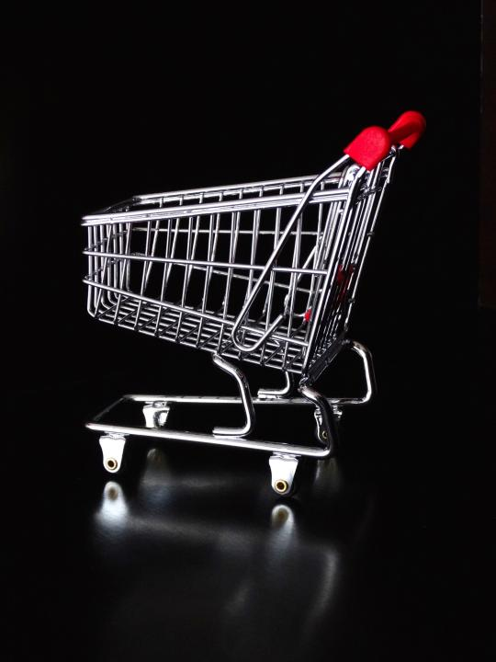
About
World Consumer Rights Day is honored on March 15 globally to accept and recognize the rights of consumers. The main reason for the day is to encourage more awareness and knowledge-gathering on customer rights worldwide.

Slide 6

“You Customer’s Perception Is Your Reality”

Slide 7





Consumer Protection
Safety
Information
Choice
Voice
Redress

Slide 8

World Consumers Rights
The consumer movement marks 15th March with World Consumer Rights Day yearly to raise global awareness around customer requests and needs. Celebrating the day is a chance to request that the rights of all consumers are appreciated and saved and to oppose market abuses and social injustices which undermine those rights.

Slide 9

International Consumer Rights Day : Significance
World Consumers Day strives to highlight that the rights of all customers are appreciated and protected and to protest market misuses and social inequities which undermine those rights.

Slide 10


International Consumer Rights Day : Observance
To celebrate in your community, look for events to bring awareness to consumer rights or areas of public policy that need to be changed. The day is about mobilizing citizen action groups worldwide, and if everyone joined in to help in their communities, it would come closer to meeting their goals.

Slide 11

“The Sustainable Consumer”.
World Consumer Rights Day 2023 Theme

Slide 12

02
Consumers Rights

Slide 13
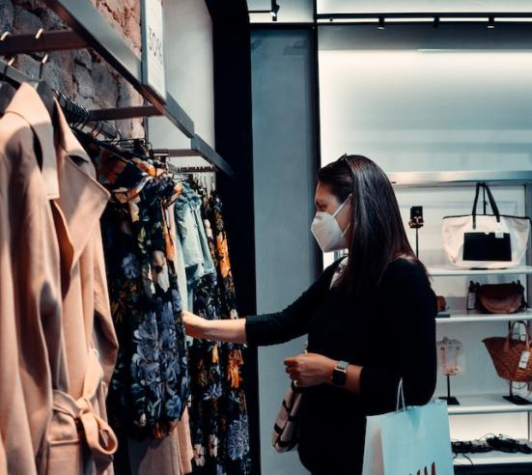
Consumer Rights
The Right To Safety
The Right To Be Informed
The Right To Choose
The Right To Be Heard.

Slide 14

The Right To Satisfaction Of Basic Needs
The Right To Redress
Consumer Rights
The Right To Consumer Education
The Right To A Healthy Environment

Slide 15

The Right To Safety
A consumer has the right to safety against such goods and services as are hazardous to his health, life, and property.

Slide 16

The Right To Be Informed
A Consumer Also Has The Right To Be Provided With All The Information On Which He Decides To Buy Goods Or Services. Such Information Relates To The Commodity's Quality, Purity, Potency, Standard, Date Of Manufacture, Method Of Use, Etc. Thus, A Producer Must Provide All Such Information Properly So The Consumer Is Not Cheated.

Slide 17

“You Are Serving A Customer Not A Life Sentence; Learn How To Enjoy Your Work”

Slide 18

The Right To Choose
A Consumer Has The Fundamental Right To Buy Any Interests Or Benefits Of His Favorite From Among The Different Goods Or Services Are Known In The Market. In Other Words, No Seller Can Unfairly Influence His Choice. If Any Seller Does So, It Will Be Deemed Interference In His Right To Choose.

Slide 19

The Right To Be Heard.
A consumer has the privilege of his complaint being heard. Beneath this Right, the consumer can file an objection against all those things which are prejudicial to his interest. First, the rights mentioned above (Right to Safety, Right to be informed, and Right to choose) has applicability only if the customer has the Right to file his complaint against them. These days, several large organizations have set up Consumer Service Cells to provide the consumer the Right to be heard.

Slide 20

The Right To Satisfaction Of Basic Needs
Basic needs mean those goods and services necessary for a dignified living. It includes adequate food, clothing, shelter, energy, sanitation, health care, education, and transportation. All consumers have the right to fulfill these basic needs.

Slide 21

This right compensates the consumers against the seller's unfair trade practices. For instance, if the quantity and quality of the product do not conform to those promised by the seller, the buyer has the right to claim compensation. Several redressals are available to the consumer through compensation, such as free repair of the product, taking back of the product with a refund of money, and changing the product by the seller.
The Right To Redress

Slide 22

The Right To Consumer Education
Consumer Education Refers To Educating Consumers Constantly About Their Rights. In Other Words, Consumers Must Be Mindful Of The Rights They Enjoy Against The Loss They Suffer On Account Of Interests And Services Purchased By Them. The Government Has Taken Several Measures To Educate Consumers.

Slide 23

The Right To A Healthy Environment
This right protects the consumer against environmental pollution so that the quality of life is enhanced. Not only this, but it also stresses the need to save the environment for future generations.

Slide 24

Consumer Rights In India
Right to choose the product.
Right to be protected from all kinds of hazardous goods.
Right to be informed about the performance and quality of all products.
Directly to be heard in all decision-making processes related to consumer interests.
Exactly to seek redressal whenever consumer rights have been infringed.
Right to complete consumer education.

Slide 25

03
Conclusion

Slide 26



How To Observe World Consumer Rights
Day
Educate Others About Their Consumer Rights
Join Consumer Rights Events
Share Your Consumer Rights Story

Slide 27
Facts
You Can Know All The Product Information
Freedom To Choose Products
You Don’t Need A Lawyer
Not Every Country Protects Online Shoppers
You Can Get Compensation

Slide 28
Why World Consumer Rights Day Is
Important
01
02
03
We Need This
Day
It’s A Day For Everyone
It Can Bring Change

Slide 29

“Your customer doesn’t care how much you know until they know how much you care”

Slide 30

World Consumers Rights Day Dates
Year | Date | Day
2023 | March 15 | Wednesday
2024 | March 15 | Friday
2025 | March 15 | Saturday
2026 | March 15 | Sunday
2027 | March 15 | Monday

Slide 31
Icons

Slide 32
Icons

Slide 33
How To Edit Shapes
You can add and edit some shapes to your presentation to present your data in a visual way.
Choose your favourite infographic and insert it in your presentation using Ctrl C + Ctrl V or Cmd C + Cmd V in Mac.
Select one of the parts and ungroup it by right-clicking and choosing “Ungroup”.
Change the color by clicking on the paint bucket.
Then resize the element by clicking and dragging one of the square-shaped points of its bounding box (the cursor should look like a double-headed arrow). Remember to hold Shift while dragging to keep the proportions.
Group the elements again by selecting them, right-clicking and choosing “Group”.
Repeat the steps above with the other parts and when you’re done editing, copy the end result and paste it into your presentation.
Remember to choose the “Keep source formatting” option so that it keeps the design. For more info, please visit iTalkedTech (Tips & Tricks).

Slide 34
Terms Of Use (Free Users)
If you are a free subscriber, you should credit iTalkedTech by keeping the “Thank You” slide.
Kindly refer to the following slide for the Terms of Use for premium users.
You can:
Customize or edit this template
Use this template for both business and personal endeavors.
You can not:
Sell, rent, or second-license iTalkedTech content or its altered version.
Promulgate, unless explicitly permitted, iTalkedTech content, by iTalkedTech.
Incorporate iTalkedTech content in any database or file online or offline.
Obtain iTalkedTech content’s copyright.
Kindly refer to our Tutorial page or FAQ for advanced slide modification guidelines.

Slide 35
Terms Of Use (Premium Users)
Being a premium subscriber, you have the privilege of using this PPT template
without giving attribution to iTalkedTech or keeping the “Thank You” slide.
You can:
Customize or edit this template.
Use this template for both business and personal endeavors.
Circulate or share the editable format of this template with anyone you want.
You can not:
Sell, rent or second-license iTalkedTech content or the altered version of it.
Promulgate or include the templates in any other services database
that performs as distribution or resale platform, unless explicitly permitted, by iTalkedTech.
Incorporate the elements used in iTalkedTech’s templates separately.
Obtain iTalkedTech’s copyright for the elements used in this template as a logo or trademark.
Kindly refer to our Tutorial page or FAQ for advanced slide modification guidelines.

Slide 36
Thank You!
We respect your valuable time with iTalkedTech!
If you have any questions, please reach us
Do you have a design request, please visit our redesign page.
CREDIT: iTalkedTech created this PowerPoint template.
Let this slide be kept for attribution.
www.iTalkedTech.com

