Slide 1
Technology
“Any sufficiently advanced technology is indistinguishable from magic”

Slide 2

Introduction Of Technology
Technology refers to the tools, systems, and processes that are developed through scientific and engineering principles to solve problems and improve human life.

Slide 3

Artificial Intelligence (AI)
Artificial Intelligence (AI) is the simulation of human intelligence in machines that can learn, reason, and solve problems.

Slide 4

Blockchain Technology
Blockchain technology is a decentralized, secure, and transparent ledger system that enables peer-to-peer transactions without intermediaries.

Slide 5

Cloud Computing
Cloud computing is the delivery of on-demand computing resources over the internet, including storage, applications, and processing power.

Slide 6

Internet of Things (IoT)
Internet of Things (IoT) is a network of physical devices, vehicles, and other objects embedded with sensors and software for data exchange.

Slide 7

Virtual and Augmented Reality (VR/AR)
Virtual and Augmented Reality (VR/AR) are immersive technologies that simulate real-world environments or enhance them with digital elements.

Slide 8

5G Wireless
Technology
5G Wireless Technology is the fifth-generation mobile network that offers faster data speeds, lower latency, and expanded network capacity.

Slide 9

Quantum Computing
Quantum Computing is a type of computing that uses quantum bits (qubits) to perform complex calculations much faster than classical computers.

Slide 10
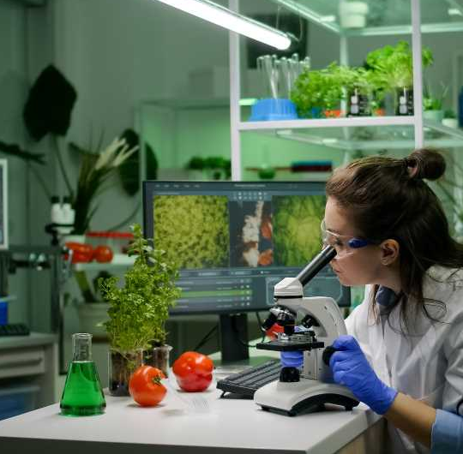
Biotechnology
Biotechnology is the application of biological science to develop and improve products, processes, and technologies in fields such as medicine and agriculture.

Slide 11
Icons

Slide 12
Icons

Slide 13
How To Edit Shapes
You can add and edit some shapes to your presentation to present your data in a visual way.
Choose your favourite infographic and insert it in your presentation using Ctrl C + Ctrl V or Cmd C + Cmd V in Mac.
Select one of the parts and ungroup it by right-clicking and choosing “Ungroup”.
Change the color by clicking on the paint bucket.
Then resize the element by clicking and dragging one of the square-shaped points of its bounding box (the cursor should look like a double-headed arrow). Remember to hold Shift while dragging to keep the proportions.
Group the elements again by selecting them, right-clicking and choosing “Group”.
Repeat the steps above with the other parts and when you’re done editing, copy the end result and paste it into your presentation.
Remember to choose the “Keep source formatting” option so that it keeps the design. For more info, please visit italkedtech (Tips & Tricks).

Slide 14
Terms Of Use (Free Users)
If you are a free subscriber, you should credit italkedtech by keeping the “Thank You” slide.
Kindly refer to the following slide for the Terms of Use for premium users.
You can:
Customize or edit this template
Use this template for both business and personal endeavors.
You can not:
Sell, rent, or second-license italkedtech content or its altered version.
Promulgate, unless explicitly permitted, italkedtech content, by italkedtech.
Incorporate italkedtech content in any database or file online or offline.
Obtain italkedtech content’s copyright.
Kindly refer to our Tutorial page or FAQ for advanced slide modification guidelines.

Slide 15
Terms Of Use (Premium Users)
Being a premium subscriber, you have the privilege of using this PPT template
without giving attribution to italkedtech or keeping the “Thank You” slide.
You can:
Customize or edit this template.
Use this template for both business and personal endeavors.
Circulate or share the editable format of this template with anyone you want.
You can not:
Sell, rent or second-license italkedtech content or the altered version of it.
Promulgate or include the templates in any other services database
that performs as distribution or resale platform, unless explicitly permitted, by italkedtech.
Incorporate the elements used in italkedtech’s templates separately.
Obtain italkedtech’s copyright for the elements used in this template as a logo or trademark.
Kindly refer to our Tutorial page or FAQ for advanced slide modification guidelines.

Slide 16



Thank You!
We respect your valuable time with italkedtech!
If you have any questions, please reach us
,
Do you have a design request, please visit our redesign page.
CREDIT: italkedtech created this PowerPoint template.
Let this slide be kept for attribution.
www.italkedtech.com

