Slide 1

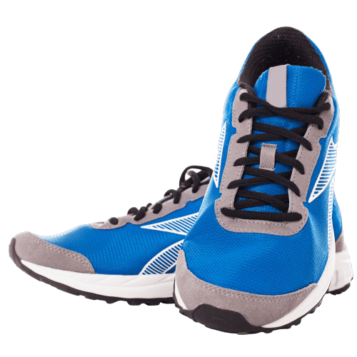
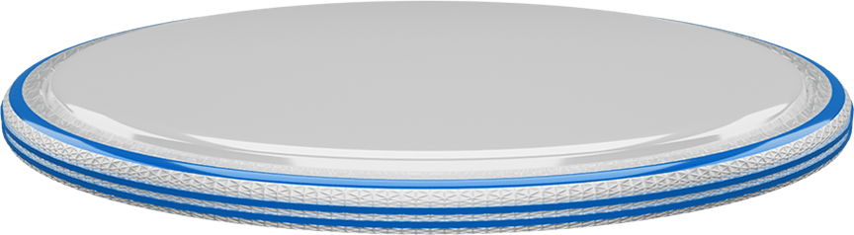

SNEAKER
PowerPoint Presentation

Slide 2
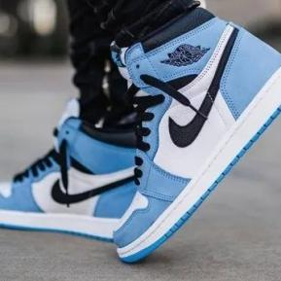
Sneaker History
Delve into the fascinating evolution of sneakers, from their humble beginnings as athletic footwear to their prominent role in street fashion and pop culture today.

Slide 3
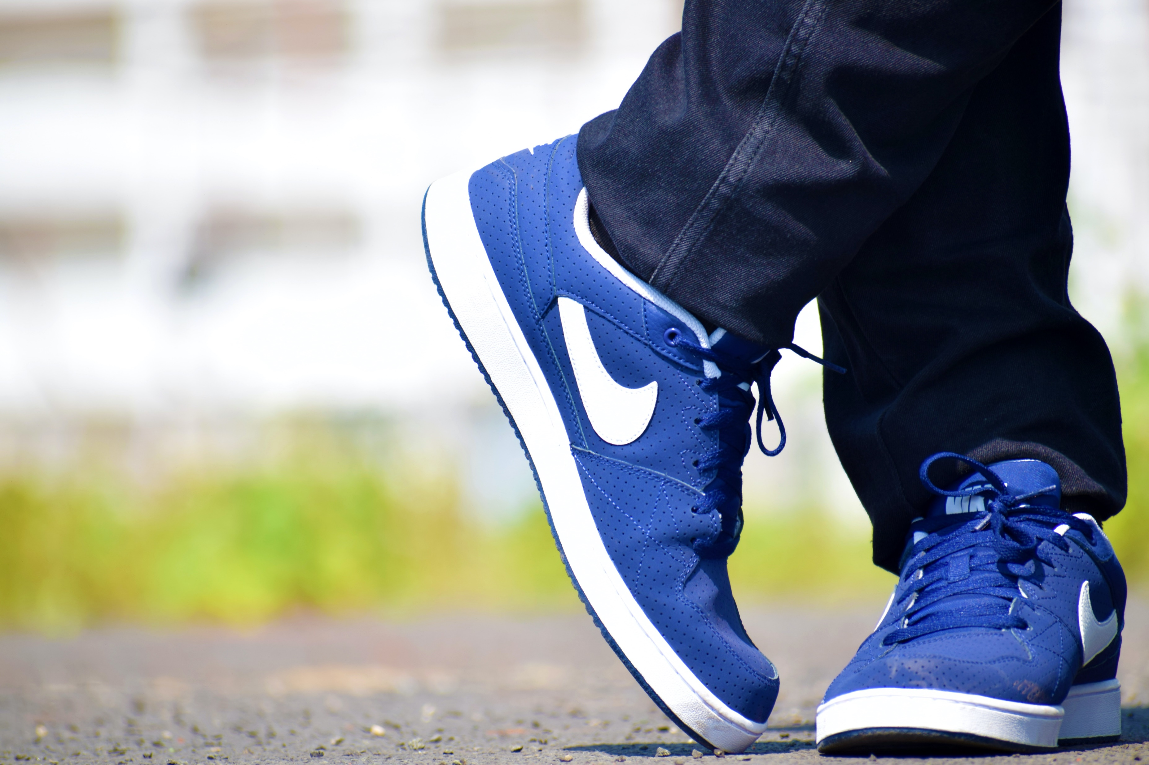
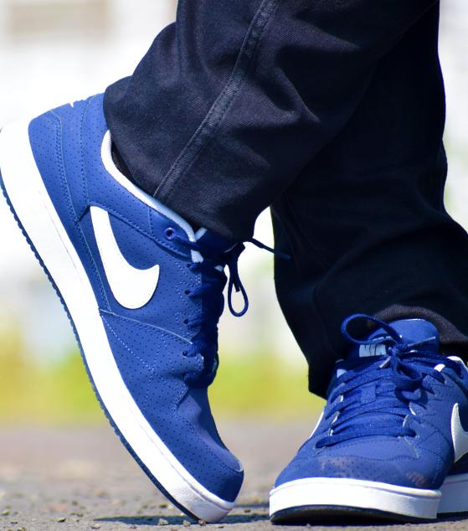
Sneaker Design
Explore the artistry behind sneaker design, examining the creative process, materials used, and the balance between functionality and aesthetics in crafting iconic footwear.
SNEAKERS

Slide 4
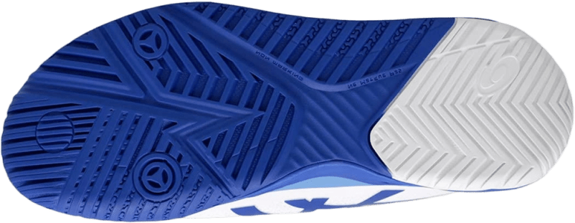
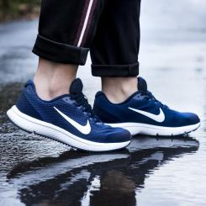
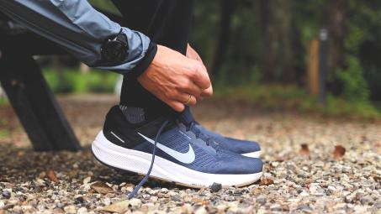
Sneaker Brands
Discover the world of sneaker brands, from industry giants like Nike and Adidas to emerging labels, and learn about their unique brand philosophies, collaborations, and innovations.

Slide 5
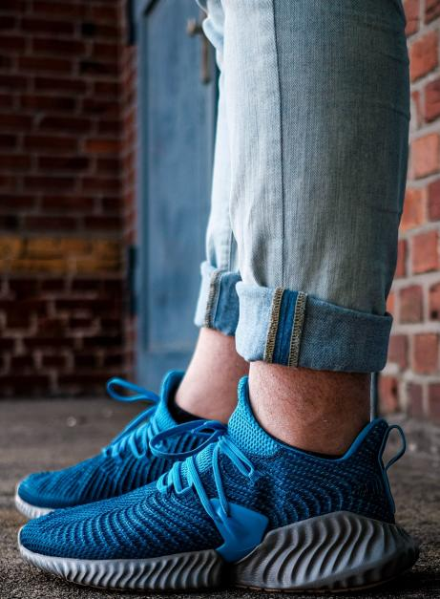
Sneaker Collecting
Uncover the passionate world of sneaker collecting, exploring the culture, hype, limited editions, and the thrill of hunting down rare and coveted sneakers.

Slide 6
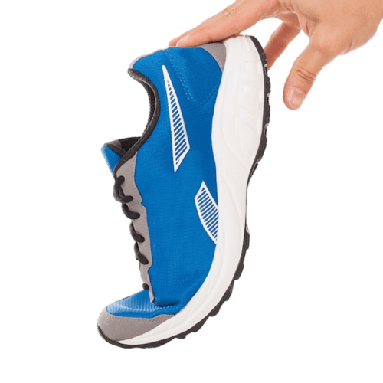
"Sneakers Are Not Just Shoes; They're A Lifestyle."

Slide 7

Sneaker Culture
Examine the influence of sneakers on contemporary culture, including their role in music, sports, fashion subcultures, and as a form of self-expression and personal identity.

Slide 8
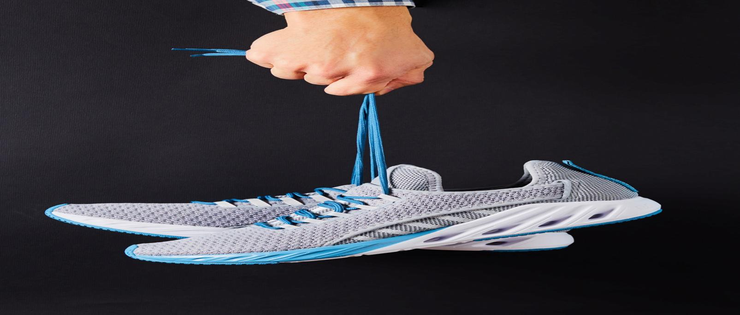
SNEAKERS
Sneaker Technology
Dive into the cutting-edge technologies used in sneaker construction, such as cushioning systems, breathable fabrics, and advanced traction, driving performance and comfort.

Slide 9
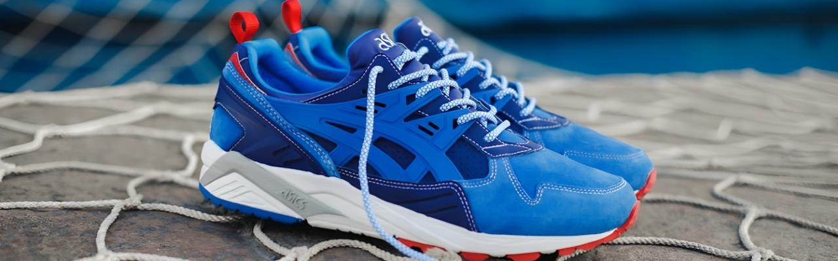
Discuss the booming sneaker resale market, examining the economics, demand, and controversies surrounding limited releases and reselling culture.
Sneaker
Resale Market

Slide 10
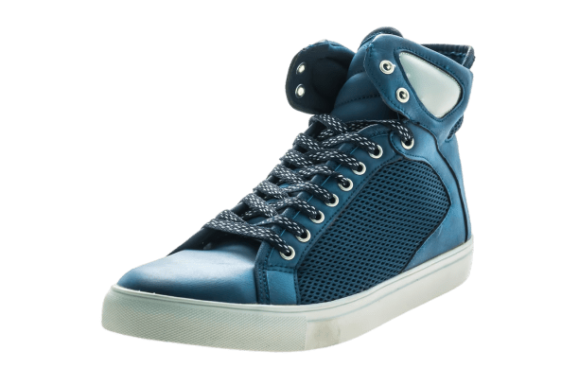
Sneakers And Sports
Explore the impact of sneakers on athletic performance, from basketball shoes providing support and traction to specialized running shoes improving speed and endurance.

Slide 11
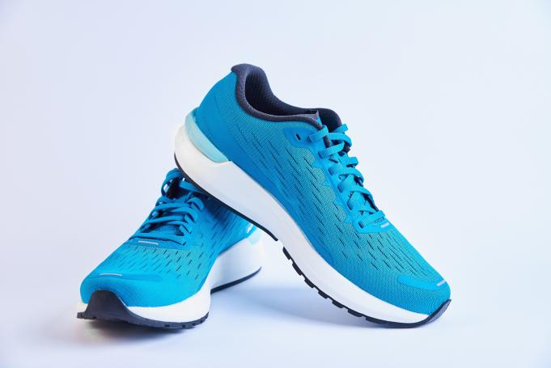
Sneakers In Fashion
Analyze the intersection of sneakers and high fashion, from runway collaborations to celebrities and influencers incorporating sneakers into their stylish ensembles.

Slide 12
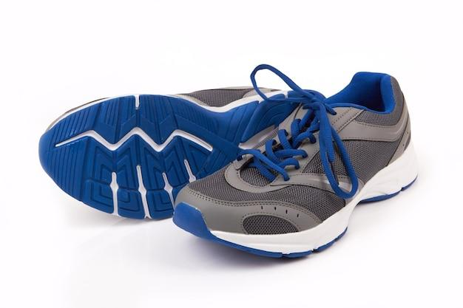
Sneakers And Sustainability
Investigate The Growing Emphasis On Sustainable Sneaker Production, Including Eco-friendly Materials, Recycling Initiatives, And Brands Prioritizing Ethical Manufacturing Practices.

Slide 13

Sneaker Customization
Highlight the trend of sneaker customization, where artists and enthusiasts personalize sneakers through painting, embroidery, and other creative techniques

Slide 14
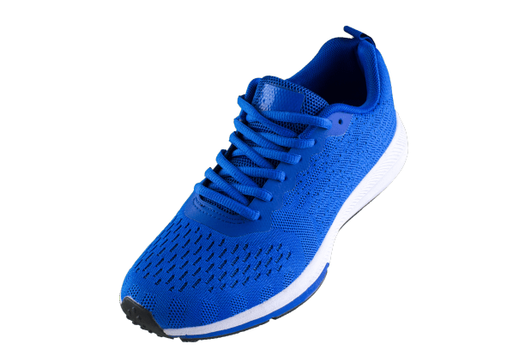
Sneakers As Cultural Symbols
Examine how certain sneakers have become iconic cultural symbols, representing specific eras, movements, or even social status within communities.

Slide 15
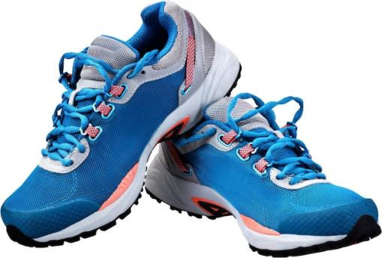
Sneakers And
Self-expression
Celebrate how sneakers have become a canvas for personal expression, allowing individuals to showcase their unique style, interests, and personality through their footwear choices.

Slide 16
Icons

Slide 17
Icons

Slide 18
How To Edit Shapes
You can add and edit some shapes to your presentation to present your data in a visual way.
Choose your favourite infographic and insert it in your presentation using Ctrl C + Ctrl V or Cmd C + Cmd V in Mac.
Select one of the parts and ungroup it by right-clicking and choosing “Ungroup”.
Change the color by clicking on the paint bucket.
Then resize the element by clicking and dragging one of the square-shaped points of its bounding box (the cursor should look like a double-headed arrow). Remember to hold Shift while dragging to keep the proportions.
Group the elements again by selecting them, right-clicking and choosing “Group”.
Repeat the steps above with the other parts and when you’re done editing, copy the end result and paste it into your presentation.
Remember to choose the “Keep source formatting” option so that it keeps the design. For more info, please visit iTalkedtech (Tips & Tricks).

Slide 19
Terms Of Use (Free Users)
If you are a free subscriber, you should credit iTalkedtech by keeping the “Thank You” slide.
Kindly refer to the following slide for the Terms of Use for premium users.
You can:
Customize or edit this template
Use this template for both business and personal endeavors.
You can not:
Sell, rent, or second-license iTalkedtech content or its altered version.
Promulgate, unless explicitly permitted, iTalkedtech content, by iTalkedtech.
Incorporate iTalkedtech content in any database or file online or offline.
Obtain iTalkedtech content’s copyright.
Kindly refer to our Tutorial page or FAQ for advanced slide modification guidelines.

Slide 20
Terms Of Use (Premium Users)
Being a premium subscriber, you have the privilege of using this PPT template
without giving attribution to iTalkedtech or keeping the “Thank You” slide.
You can:
Customize or edit this template.
Use this template for both business and personal endeavors.
Circulate or share the editable format of this template with anyone you want.
You can not:
Sell, rent or second-license iTalkedtech content or the altered version of it.
Promulgate or include the templates in any other services database
that performs as distribution or resale platform, unless explicitly permitted, by iTalkedtech.
Incorporate the elements used in iTalkedtech’s templates separately.
Obtain iTalkedtech’s copyright for the elements used in this template as a logo or trademark.
Kindly refer to our Tutorial page or FAQ for advanced slide modification guidelines.

Slide 21





Thank You!
We respect your valuable time with italkedtech!
If you have any questions, please reach us
,
Do you have a design request, please visit our redesign page.
CREDIT: italkedtech created this PowerPoint template.
Let this slide be kept for attribution.
www.italkedtech.com

