Slide 1
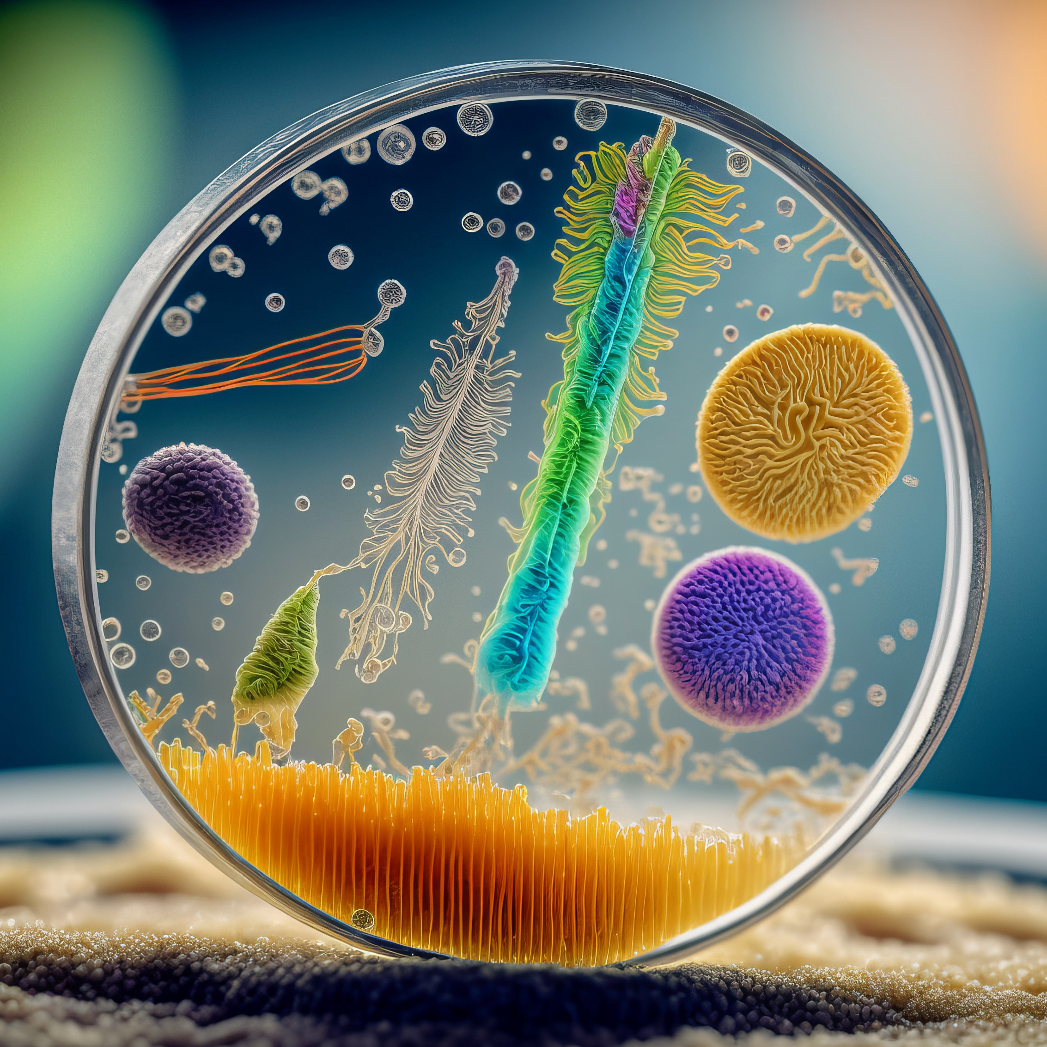
LOGO HERE
MICROBIOLOGY
“In the world of microbes, small things can have a big impact.”

Slide 2
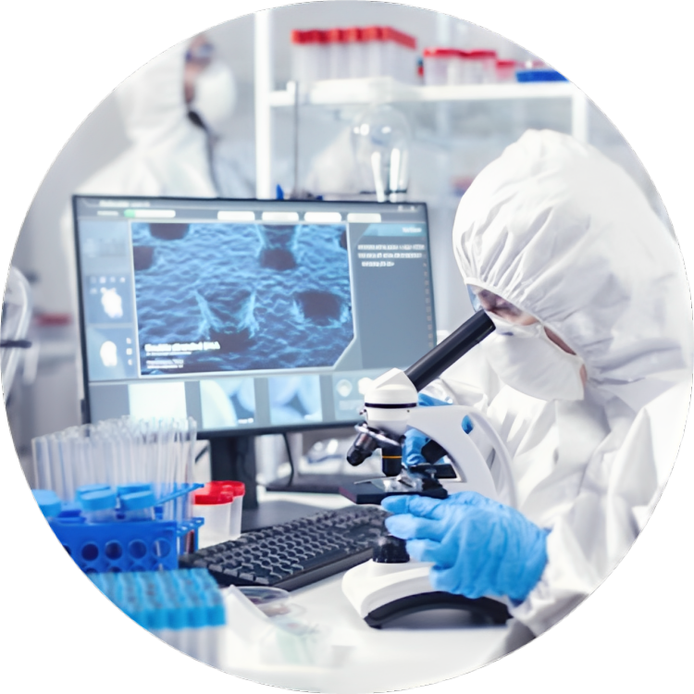
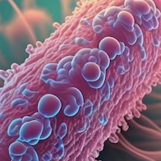
Bacteria
Bacteria are single-celled microorganisms that can be found almost everywhere on Earth. They play crucial roles in various ecosystems, including nutrient cycling, digestion, and
disease-causing infections.

Slide 3
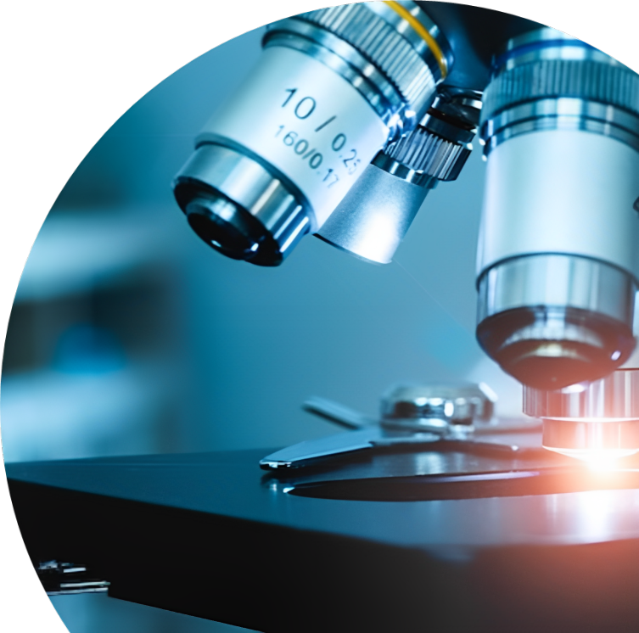
Viruses
Viruses are tiny infectious agents that can only replicate inside host cells. They are responsible for numerous diseases in humans, animals, and plants. Understanding viral structure and behavior is essential for developing effective treatments and vaccines.

Slide 4
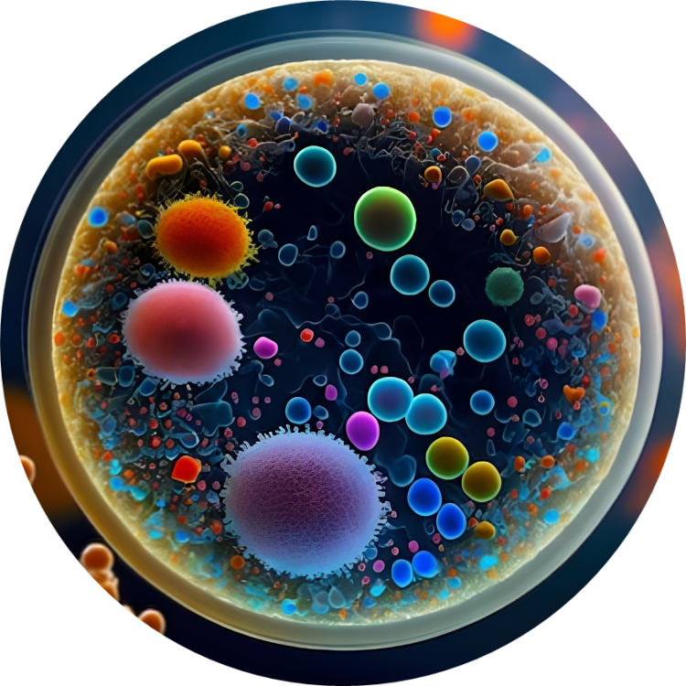

Fungi
Fungi are diverse microorganisms that include molds, yeasts, and mushrooms. They can be beneficial, such as in food production (e.g., baking bread) or harmful, causing diseases like athlete's foot and fungal infections.
Fungi are more closely related to animals than plants, despite their often plant-like appearances.

Slide 5
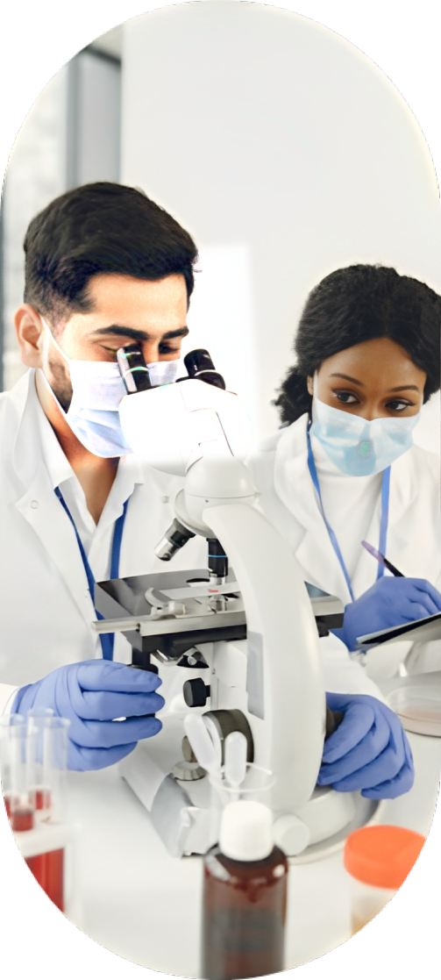

Antibiotics: Medications that kill or inhibit the growth of bacteria to treat bacterial infections.
Antibiotics And Antimicrobial Resistance
Antibiotics are drugs used to treat bacterial infections, but the misuse and overuse of antibiotics have led to the emergence of antimicrobial resistance. Studying microbial resistance mechanisms is vital for developing new strategies to combat resistant pathogens.
Antimicrobial Resistance: The ability of microorganisms to resist the effects of antibiotics, making them less effective in treating infections.
Overuse and Misuse: Inappropriate and excessive use of antibiotics can contribute to the development of antimicrobial resistance.

Slide 6
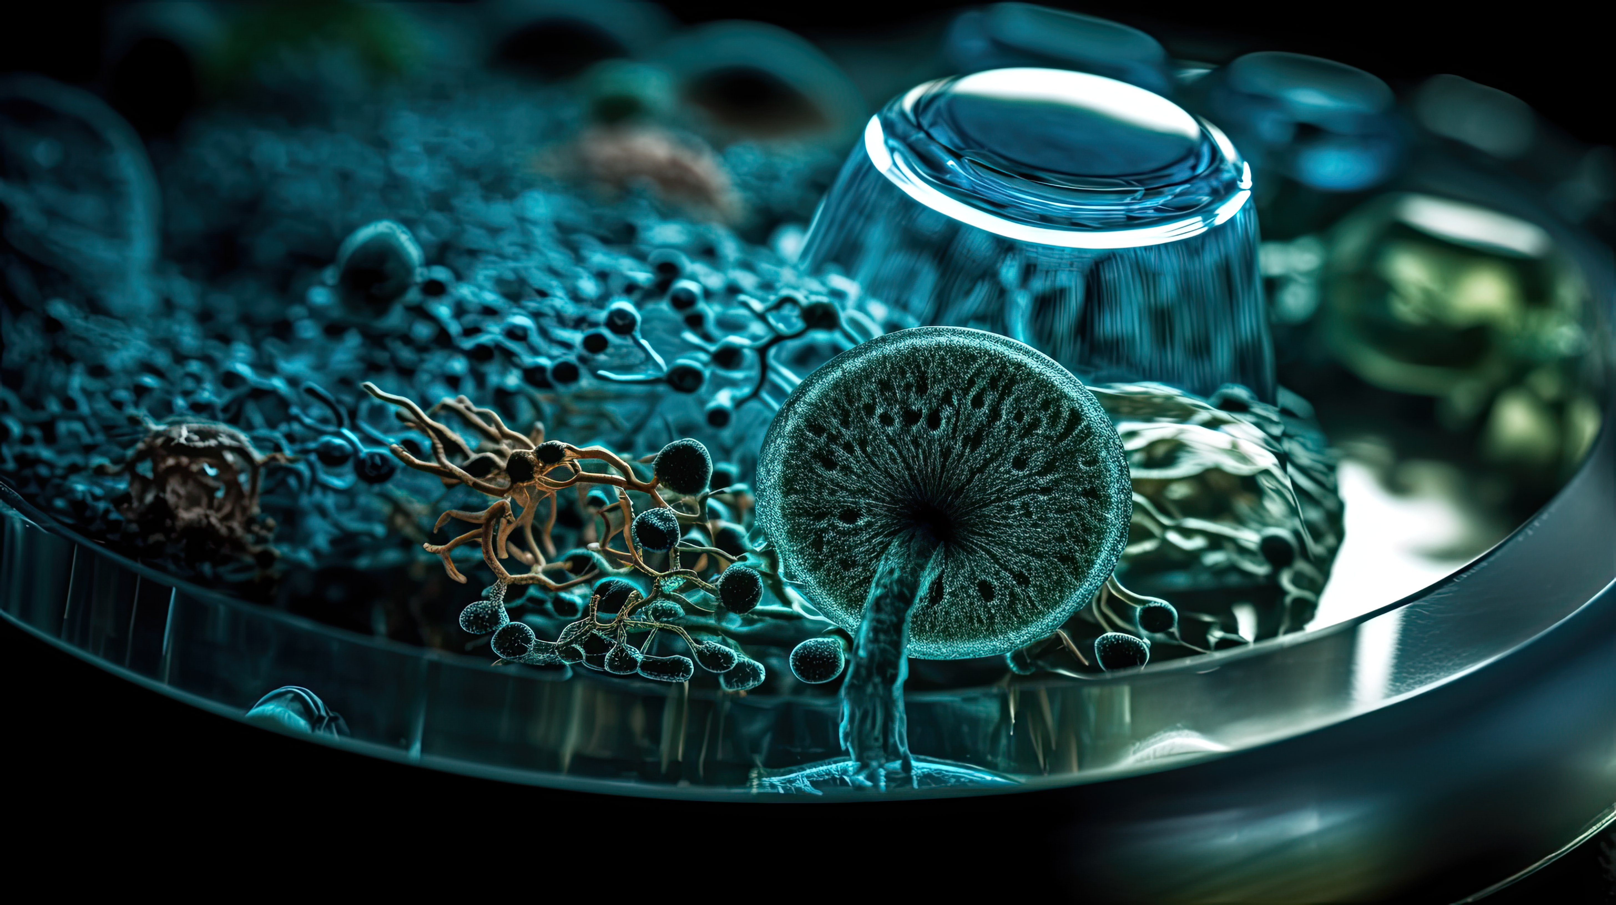
Protozoa
Protozoa are single-celled eukaryotic microorganisms. They are found in various environments, including soil, water, and the human body. Some species are responsible for diseases like malaria and amoebic dysentery.

Slide 7


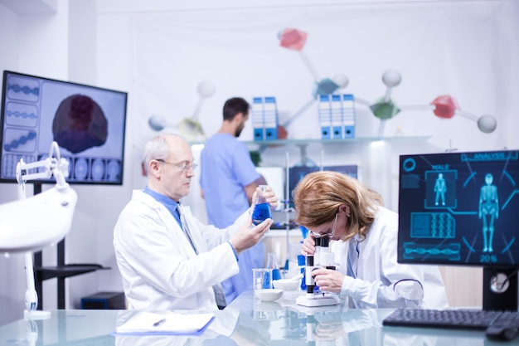
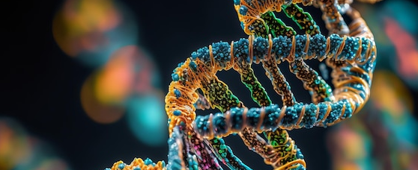
Microbial Genetics
Microbial genetics focuses on the study of genetic material and mechanisms in microorganisms. Understanding microbial genetics helps unravel the diversity, evolution, and potential applications of microbes.

Slide 8
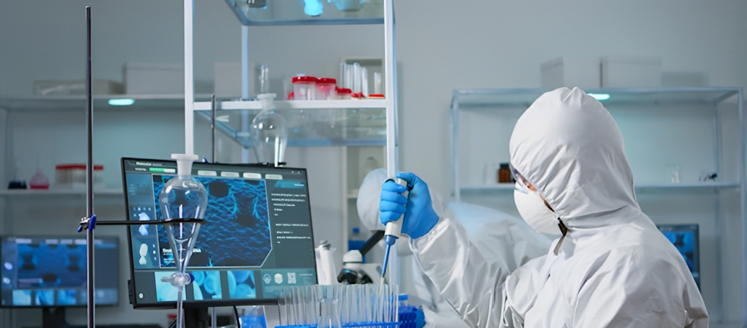
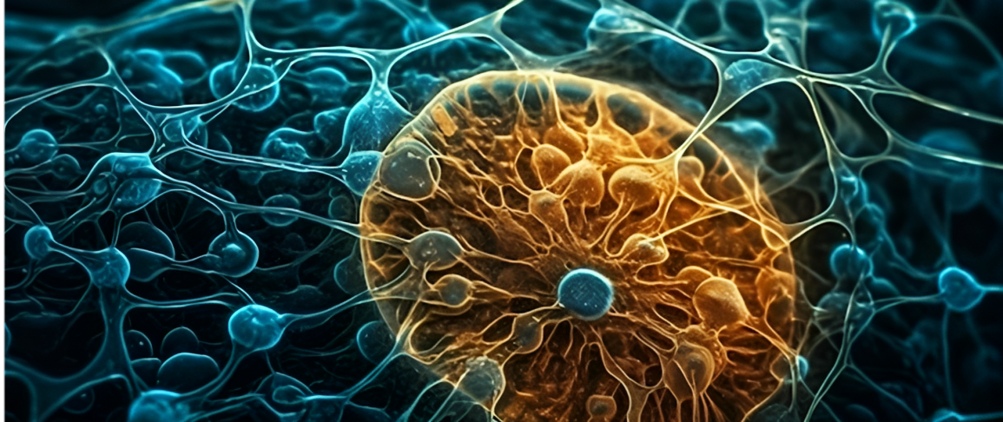
01
02
Innate Immunity: Rapid and nonspecific defense mechanism against pathogens.
Adaptive Immunity: Highly specific defense system that develops over time.
03
04
Passive Immunity: Temporary immunity acquired through the transfer of antibodies.
Autoimmunity: Immune system attacks the body's own cells and tissues.

Slide 9
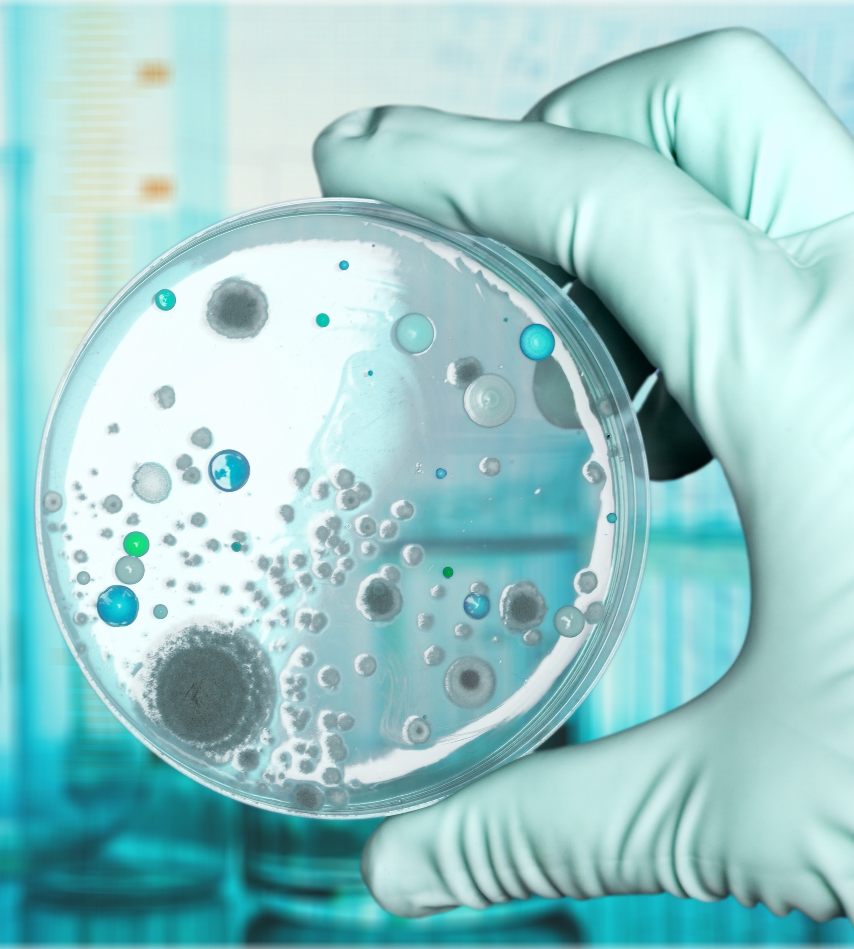

Microbial ecology examines the interactions between microorganisms and their environment. It explores microbial communities, their roles in nutrient cycling, symbiotic relationships, and their impact on ecosystem stability.
Microbial Ecology

Slide 10

Conclusion
Microbiology is a vast and vital field that unravels the complexities of microorganisms, their roles in various ecosystems, and their impact on human health. Through its research and discoveries, microbiology provides valuable insights and drives advancements in medicine, agriculture, and environmental conservation.

Slide 11
Icons

Slide 12
Icons

Slide 13
How To Edit Shapes
You can add and edit some shapes to your presentation to present your data in a visual way.
Choose your favourite infographic and insert it in your presentation using Ctrl C + Ctrl V or Cmd C + Cmd V in Mac.
Select one of the parts and ungroup it by right-clicking and choosing “Ungroup”.
Change the color by clicking on the paint bucket.
Then resize the element by clicking and dragging one of the square-shaped points of its bounding box (the cursor should look like a double-headed arrow). Remember to hold Shift while dragging to keep the proportions.
Group the elements again by selecting them, right-clicking and choosing “Group”.
Repeat the steps above with the other parts and when you’re done editing, copy the end result and paste it into your presentation.
Remember to choose the “Keep source formatting” option so that it keeps the design. For more info, please visit iTalkedtech (Tips & Tricks).

Slide 14
Terms Of Use (Free Users)
If you are a free subscriber, you should credit iTalkedtech by keeping the “Thank You” slide.
Kindly refer to the following slide for the Terms of Use for premium users.
You can:
Customize or edit this template
Use this template for both business and personal endeavors.
You can not:
Sell, rent, or second-license iTalkedtech content or its altered version.
Promulgate, unless explicitly permitted, iTalkedtech content, by iTalkedtech.
Incorporate iTalkedtech content in any database or file online or offline.
Obtain iTalkedtech content’s copyright.
Kindly refer to our Tutorial page or FAQ for advanced slide modification guidelines.

Slide 15
Terms Of Use (Premium Users)
Being a premium subscriber, you have the privilege of using this PPT template
without giving attribution to iTalkedtech or keeping the “Thank You” slide.
You can:
Customize or edit this template.
Use this template for both business and personal endeavors.
Circulate or share the editable format of this template with anyone you want.
You can not:
Sell, rent or second-license iTalkedtech content or the altered version of it.
Promulgate or include the templates in any other services database
that performs as distribution or resale platform, unless explicitly permitted, by iTalkedtech.
Incorporate the elements used in iTalkedtech’s templates separately.
Obtain iTalkedtech’s copyright for the elements used in this template as a logo or trademark.
Kindly refer to our Tutorial page or FAQ for advanced slide modification guidelines.

Slide 16





Thank You!
We respect your valuable time with italkedtech!
If you have any questions, please reach us
,
Do you have a design request, please visit our redesign page.
CREDIT: italkedtech created this PowerPoint template.
Let this slide be kept for attribution.
www.italkedtech.com

