Slide 1

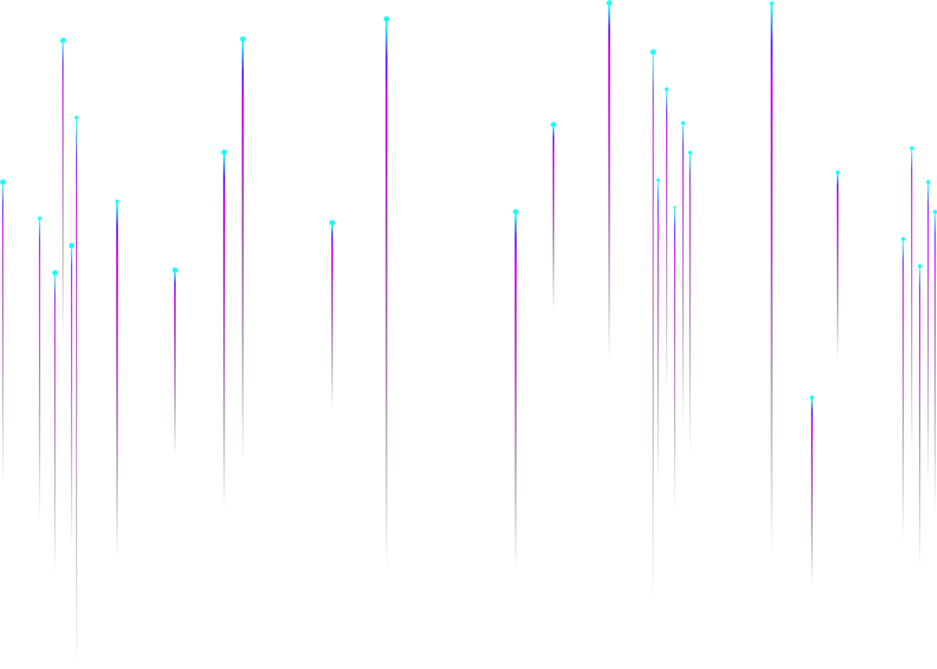
Metaverse Presentation Template

Slide 2
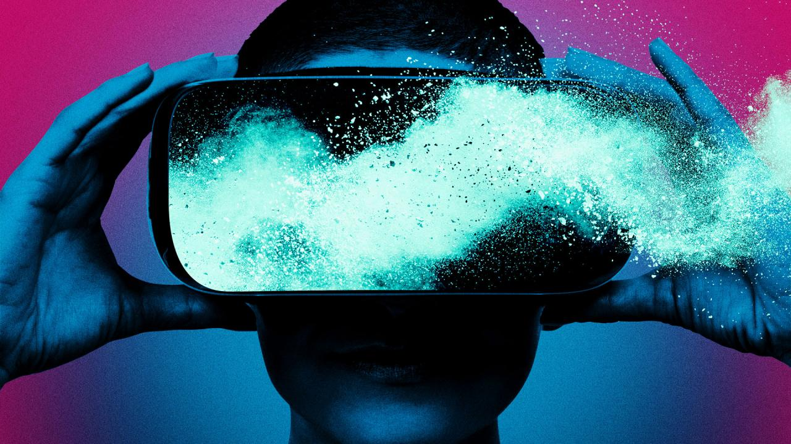
"Metaverse isn't a thing a company builds. It's the next chapter of the internet overall."

Slide 3
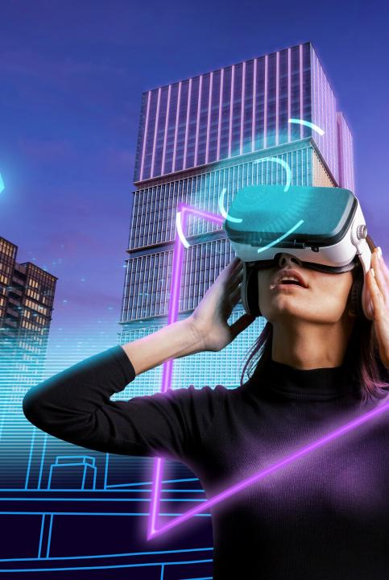
Introduction
The computer screens we operate today to connect to a worldwide web of knowledge have evolved portals to 3D virtual. Digital facsimiles of ourselves, or avatars, move freely from one experience to another.

Slide 4

What Is Metaverse
The metaverse is a concept of what many in the computer industry acknowledge is the next iteration of the internet: a single, immersive, shared, persistent, 3D virtual area where humans experience life in forms they could not exist in the physical world.

Slide 5
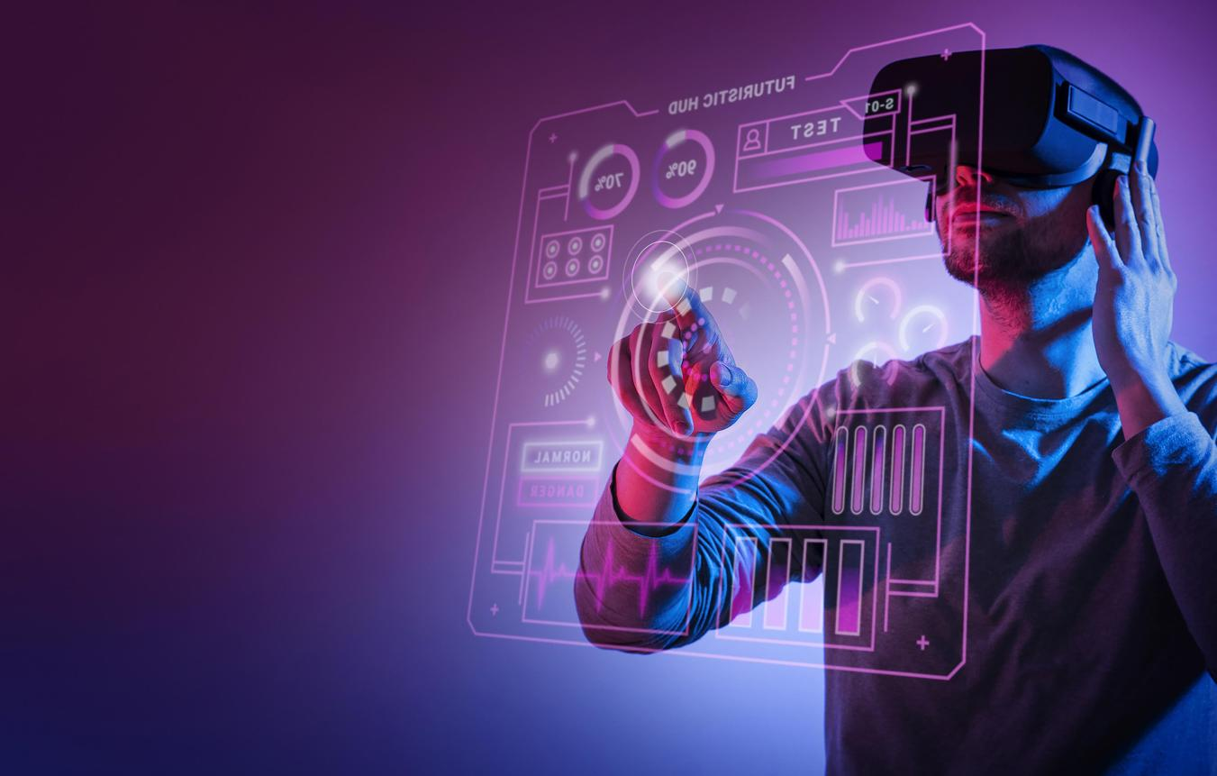
History
The term "metaverse" formed in the 1992 science fantasy novel Snow Crash as a portmanteau of "meta" and "universe." Metaverse development is often related to advancing virtual reality technology due to the increasing demands for immersion.

Slide 6

Key Characteristics Of Metaverse
01
02
03
Boundless
Immersive
Social Experience
No barriers between real or digital, endless metaverse
Realistic sensory experience with extended reality
Creating events meant to be shared together
04
05
06
Persistent
Decentralized
Economy
Always active, can’t but unplugged
No single entity has control over metaverse
Digital currencies helps virtual currencies

Slide 7
Activities In The Metaverse
Play
Enjoy
Work
Buy
Look
Socialize

Slide 8
What Is The Metaverse And How Does It Work?
Metaverse is a network of 3D digital globes where users can connect, interact, and gain knowledge of things the same as in the natural world. The virtual globe of the metaverse is developed & managed through various technologies like Augmented Reality (AR), Virtual Reality (VR), Cryptocurrencies, NFTs, Internet, etc.

Slide 9

How Is
The Metaverse
Accessed?
Virtual reality
Augmented reality
A computer-generated environment with natural scenes and objects makes the user feel immersed in their surroundings.
The real-time use of information in text, graphics, audio, and other virtual enhancements combined with real-world objects.

Slide 10
Future Of Virtual Reality
Establishing legal organizations in the metaverse.
Data security and protection: license of content.
Service related to intellectual property, such as copyrights, trademarks, patents, etc.
Deals involving technology

Slide 11
Elements Of Metaverse
Web 3.0
Blockchain Protocols
NFTs
Games
Cryptocurrencies/Tokens
Augmented Reality (AR)
Virtual Reality (VR)
Mixed reality (MR)

Slide 12
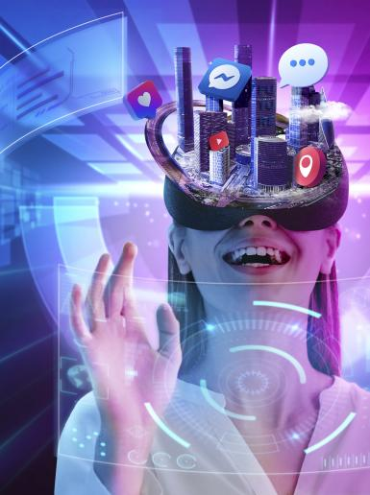
What Is Web3
Web3 is a term used to define a decentralized internet created on a blockchain foundation. Central to Web3’s belief is that power over the internet will ultimately swing out from a handful of tech giants toward developers and the many unique users.
That said, none of Web3’s core tenets run heretical to those of the metaverse.

Slide 13

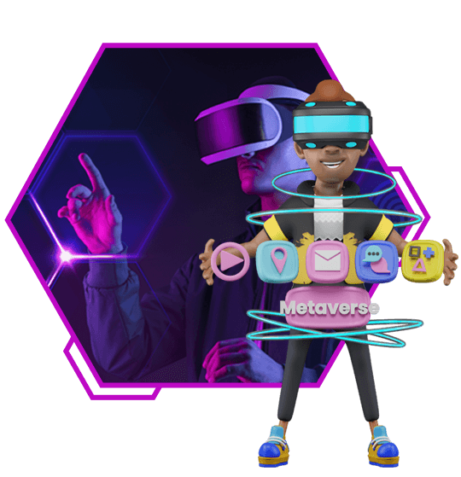
V.s
Web 3.0
Metaverse

Slide 14

An NFT is a digital asset describing real-world objects like art, in-game items, music, and videos. They are bought and sold online repeatedly with cryptocurrency and are generally encoded with the same underlying software as more cryptos.
NFTS

Slide 15
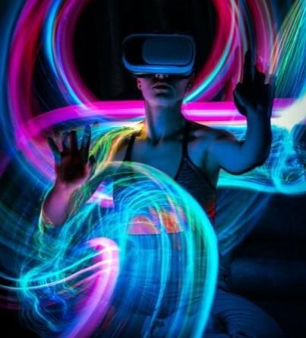
Cryptocurrencies/
Tokens
A cryptocurrencies token is a virtual currency token or cryptocurrency denomination. It represents a tradable asset or utility that resides on its blockchain and allows the holder to use it for investment or economic purposes.

Slide 16
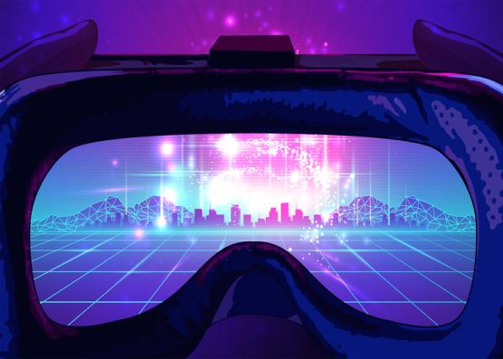
Blockchain protocols are a stage of protocols used to manage the blockchain network. The rules describe the interface of the network, interaction between the computers, kind of data, incentives, etc.
Blockchain Protocols

Slide 17
“In simplest terms, the metaverse is the internet, but in 3D.”

Slide 18
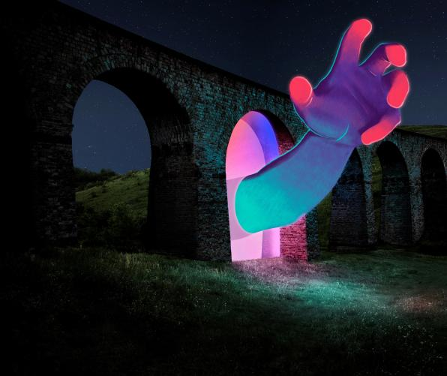
How To Access The Metaverse
Hardware
A combination of specialized hardware (computers, phones, headsets, 3D screens, gloves, etc.)
software
a combination of specialized software (games, programs, etc.)

Slide 19

Metaverse Technologies
Artificial intelligence
Internet of things
Extended reality
Brain-computer interfaces
3D modeling and reconstruction
Spatial and edge computing
Blockchain

Slide 20

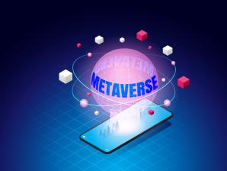
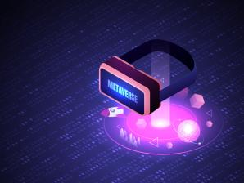
How Should Businesses Prepare For The Metaverse?
Enhancing teamwork and collaboration
Enabling faster learning.
Assessing operations

Slide 21
Access
Game Developer
Focus On the Game and leave NFT solutions
Software
A combination of specialized software
Hardware
A combination of specialized hardware (computers, phones, headsets, 3D screens, gloves, etc.)

Slide 22
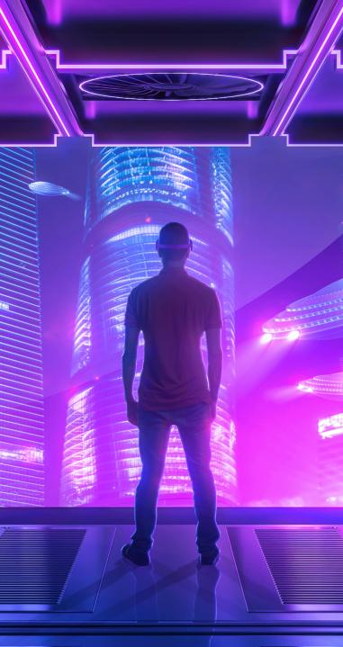
The Metaverse In Theory
The metaverse as a product or service
The metaverse as a place
The metaverse as a moment

Slide 23





Technologies Converging
VR/AR
5G/6G
Blockchain/NFT
Cloud Computing

Slide 24

Properties Of The Metaverse
Crafted by an exponential on the exponential rise in creators
With the ability to link and embed immersive, emergent content
In immersive places in which the self is present
Emphasis on activities

Slide 25
What Can You Do In Metaverse?
01
02
03
Make a virtual property
Advertise Anything
Own digital properties
04
05
06
Earn money by investing in NFTs
Get a job in the metaverse
Socialize & make new friends

Slide 26

Possible Perils Of The Metaverse
47%
Tech addiction & losing touch with reality
41%
Mental health issues (depression, anxiety)
35%
Obesity

Slide 27

Interested In Participating In
A Metaverse

Slide 28

Metaverse Popularity Breakdown

Slide 29

Conclusion
The metaverse technology will bring with it particular challenges. Some of these issues can only be resolved by making slight or significant modifications to a company’s operations. As previously said, the Metaverse will usher in a new era of consumer behavior. But, for the time being, all is in its infancy.

Slide 30

“There’s not an agreement on what the metaverse is, even though one company has changed its name in anticipation of defining it.”

Slide 31
Icons

Slide 32
Icons

Slide 33
How To Edit Shapes
You can add and edit some shapes to your presentation to present your data in a visual way.
Choose your favourite infographic and insert it in your presentation using Ctrl C + Ctrl V or Cmd C + Cmd V in Mac.
Select one of the parts and ungroup it by right-clicking and choosing “Ungroup”.
Change the color by clicking on the paint bucket.
Then resize the element by clicking and dragging one of the square-shaped points of its bounding box (the cursor should look like a double-headed arrow). Remember to hold Shift while dragging to keep the proportions.
Group the elements again by selecting them, right-clicking and choosing “Group”.
Repeat the steps above with the other parts and when you’re done editing, copy the end result and paste it into your presentation.
Remember to choose the “Keep source formatting” option so that it keeps the design. For more info, please visit italkedtech (Tips & Tricks).

Slide 34
Terms Of Use (Free Users)
If you are a free subscriber, you should credit italkedtech by keeping the “Thank You” slide.
Kindly refer to the following slide for the Terms of Use for premium users.
You can:
Customize or edit this template
Use this template for both business and personal endeavors.
You can not:
Sell, rent, or second-license italkedtech content or its altered version.
Promulgate, unless explicitly permitted, italkedtech content, by italkedtech.
Incorporate italkedtech content in any database or file online or offline.
Obtain italkedtech content’s copyright.
Kindly refer to our Tutorial page or FAQ for advanced slide modification guidelines.

Slide 35
Terms Of Use (Premium Users)
Being a premium subscriber, you have the privilege of using this PPT template
without giving attribution to italkedtech or keeping the “Thank You” slide.
You can:
Customize or edit this template.
Use this template for both business and personal endeavors.
Circulate or share the editable format of this template with anyone you want.
You can not:
Sell, rent or second-license italkedtech content or the altered version of it.
Promulgate or include the templates in any other services database
that performs as distribution or resale platform, unless explicitly permitted, by italkedtech.
Incorporate the elements used in italkedtech templates separately.
Obtain italkedtech copyright for the elements used in this template as a logo or trademark.
Kindly refer to our Tutorial page or FAQ for advanced slide modification guidelines.

Slide 36





Thank You!
We respect your valuable time with italkedtech!
If you have any questions, please reach us
,
Do you have a design request, please visit our redesign page.
CREDIT: italkedtech created this PowerPoint template.
Let this slide be kept for attribution.
www.italkedtech.com

