Slide 1
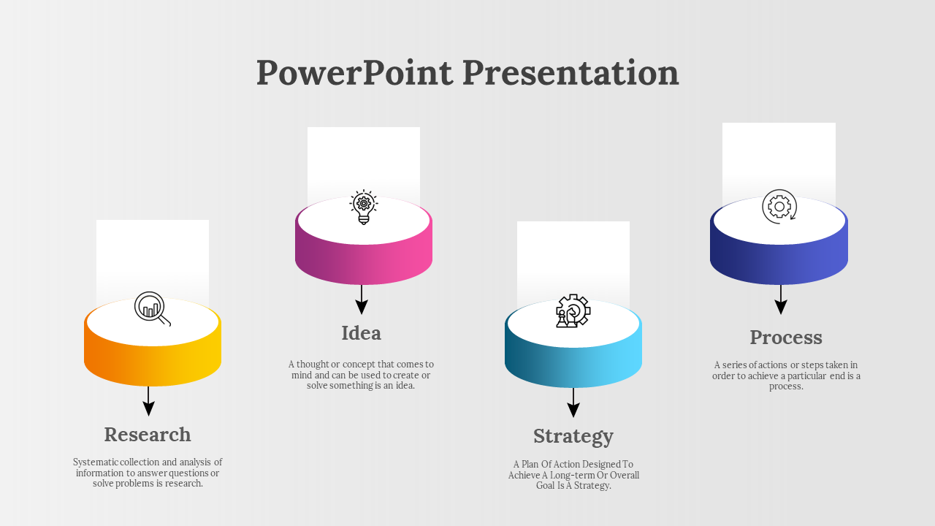
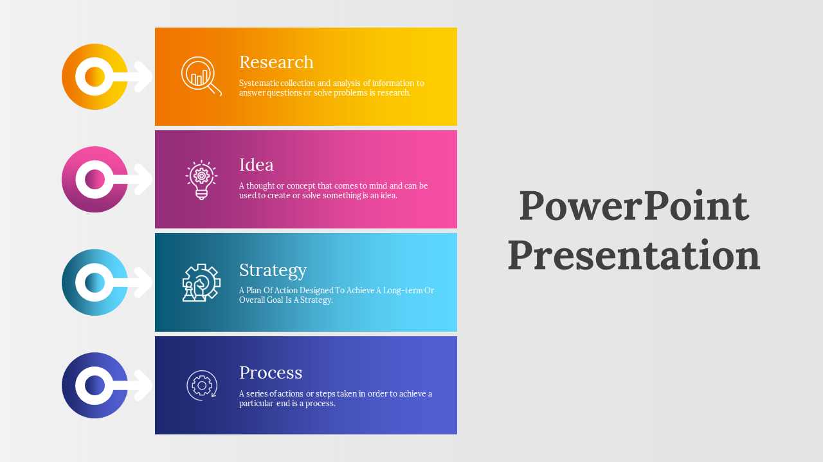
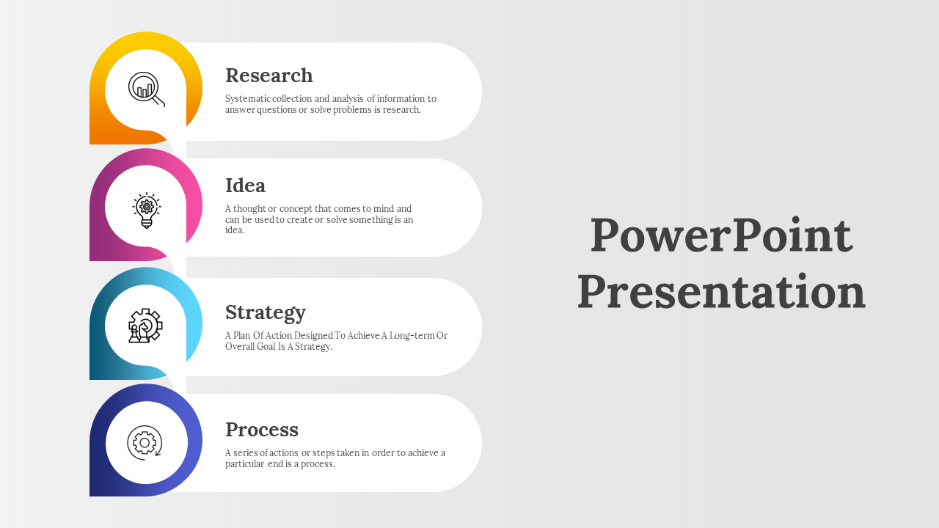
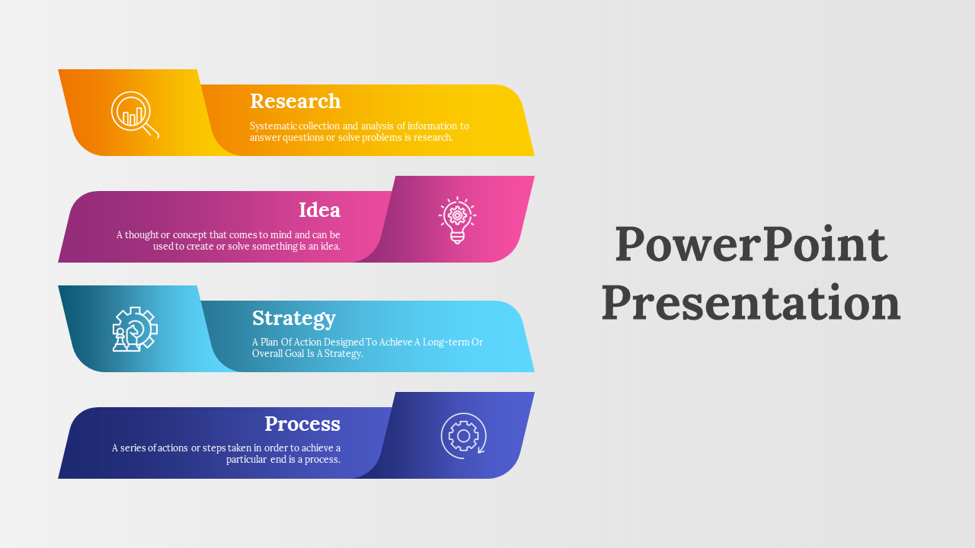
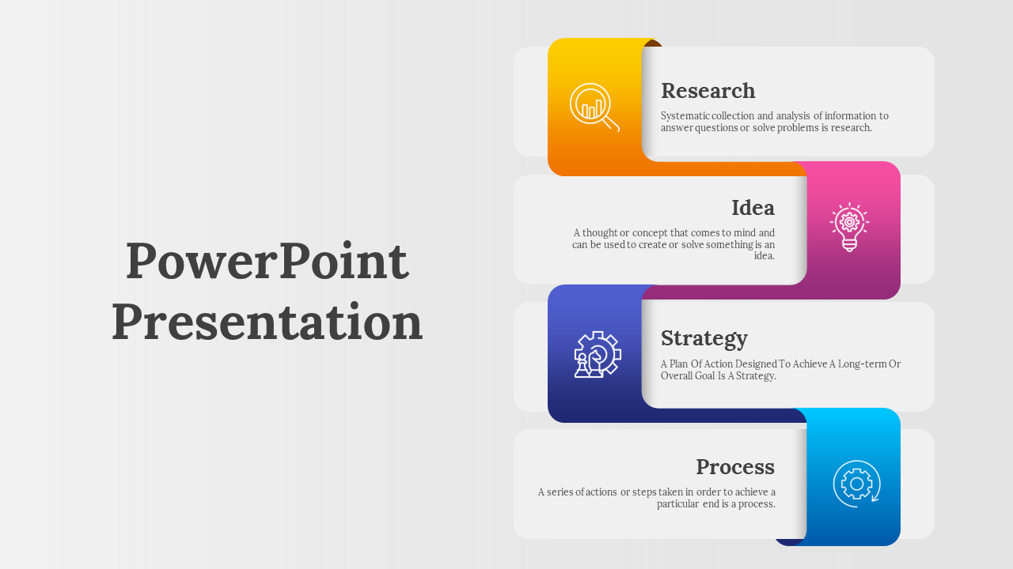
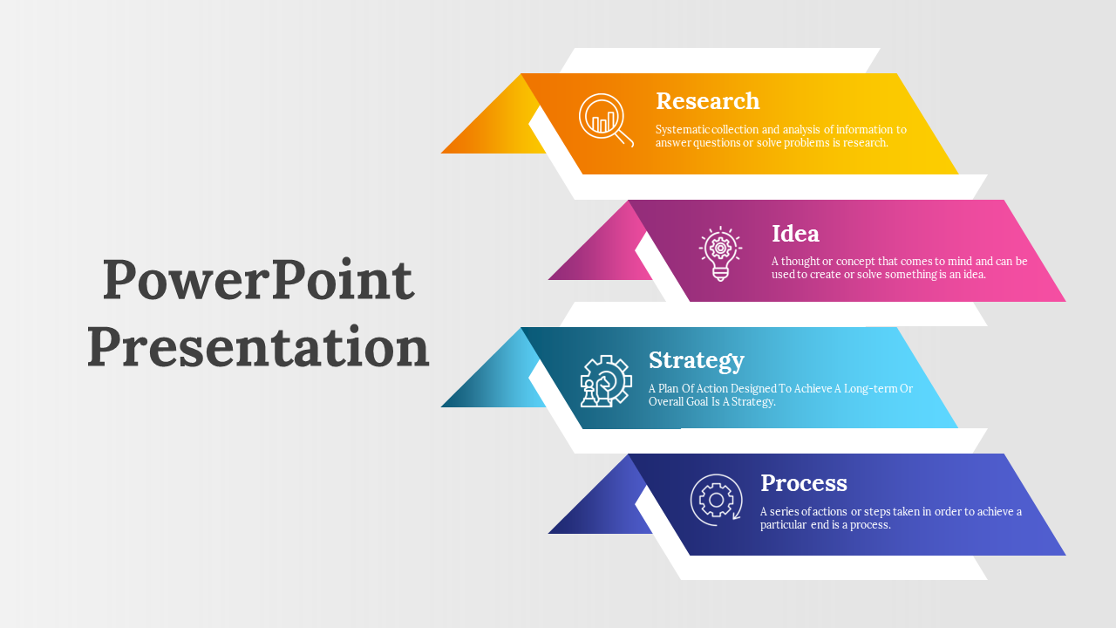
PowerPoint Presentation

Slide 2




PowerPoint Presentation
Idea
Process
A thought or concept that comes to mind and can be used to create or solve something is an idea.
A series of actions or steps taken in order to achieve a particular end is a process.
Research
Strategy
Systematic collection and analysis of information to answer questions or solve problems is research.
A Plan Of Action Designed To Achieve A Long-term Or Overall Goal Is A Strategy.

Slide 3




Research
Systematic collection and analysis of information to answer questions or solve problems is research.
Idea
A thought or concept that comes to mind and can be used to create or solve something is an idea.
PowerPoint Presentation
Strategy
A Plan Of Action Designed To Achieve A Long-term Or Overall Goal Is A Strategy.
Process
A series of actions or steps taken in order to achieve a particular end is a process.

Slide 4
Research
Systematic collection and analysis of information to answer questions or solve problems is research.
Idea
PowerPoint Presentation
A thought or concept that comes to mind and can be used to create or solve something is an idea.
Strategy
A Plan Of Action Designed To Achieve A Long-term Or Overall Goal Is A Strategy.
Process
A series of actions or steps taken in order to achieve a particular end is a process.

Slide 5
Research
Systematic collection and analysis of information to answer questions or solve problems is research.
Idea
PowerPoint Presentation
A thought or concept that comes to mind and can be used to create or solve something is an idea.
Strategy
A Plan Of Action Designed To Achieve A Long-term Or Overall Goal Is A Strategy.
Process
A series of actions or steps taken in order to achieve a particular end is a process.

Slide 6
Research
Systematic collection and analysis of information to answer questions or solve problems is research.
Idea
PowerPoint Presentation
A thought or concept that comes to mind and can be used to create or solve something is an idea.
Strategy
A Plan Of Action Designed To Achieve A Long-term Or Overall Goal Is A Strategy.
Process
A series of actions or steps taken in order to achieve a particular end is a process.

Slide 7

Research
Systematic collection and analysis of information to answer questions or solve problems is research.
Idea
A thought or concept that comes to mind and can be used to create or solve something is an idea.
PowerPoint Presentation
Strategy
A Plan Of Action Designed To Achieve A Long-term Or Overall Goal Is A Strategy.
Process
A series of actions or steps taken in order to achieve a particular end is a process.

Slide 8

PowerPoint Presentation
Research
Idea
Systematic collection and analysis of information to answer questions or solve problems is research.
A thought or concept that comes to mind and can be used to create or solve something is an idea.
Strategy
Process
A Plan Of Action Designed To Achieve A Long-term Or Overall Goal Is A Strategy.
A series of actions or steps taken in order to achieve a particular end is a process.

Slide 9

Research
Systematic collection and analysis of information to answer questions or solve problems is research.
PowerPoint Presentation
Strategy
Idea
A Plan Of Action Designed To Achieve A Long-term Or Overall Goal Is A Strategy.
A thought or concept that comes to mind and can be used to create or solve something is an idea.
Process
A series of actions or steps taken in order to achieve a particular end is a process.

Slide 10
Research
Systematic collection and analysis of information to answer questions or solve problems is research.
Idea
PowerPoint Presentation
A thought or concept that comes to mind and can be used to create or solve something is an idea.
Strategy
A Plan Of Action Designed To Achieve A Long-term Or Overall Goal Is A Strategy.
Process
A series of actions or steps taken in order to achieve a particular end is a process.

Slide 11
Icons

Slide 12
Icons

Slide 13
How To Edit Shapes
You can add and edit some shapes to your presentation to present your data in a visual way.
Choose your favourite infographic and insert it in your presentation using Ctrl C + Ctrl V or Cmd C + Cmd V in Mac.
Select one of the parts and ungroup it by right-clicking and choosing “Ungroup”.
Change the color by clicking on the paint bucket.
Then resize the element by clicking and dragging one of the square-shaped points of its bounding box (the cursor should look like a double-headed arrow). Remember to hold Shift while dragging to keep the proportions.
Group the elements again by selecting them, right-clicking and choosing “Group”.
Repeat the steps above with the other parts and when you’re done editing, copy the end result and paste it into your presentation.
Remember to choose the “Keep source formatting” option so that it keeps the design. For more info, please visit iTalkedtech (Tips & Tricks).

Slide 14
Terms Of Use (Free Users)
If you are a free subscriber, you should credit iTalkedtech by keeping the “Thank You” slide.
Kindly refer to the following slide for the Terms of Use for premium users.
You can:
Customize or edit this template
Use this template for both business and personal endeavors.
You can not:
Sell, rent, or second-license iTalkedtech content or its altered version.
Promulgate, unless explicitly permitted, iTalkedtech content, by iTalkedtech.
Incorporate iTalkedtech content in any database or file online or offline.
Obtain iTalkedtech content’s copyright.
Kindly refer to our Tutorial page or FAQ for advanced slide modification guidelines.

Slide 15
Terms Of Use (Premium Users)
Being a premium subscriber, you have the privilege of using this PPT template
without giving attribution to iTalkedtech or keeping the “Thank You” slide.
You can:
Customize or edit this template.
Use this template for both business and personal endeavors.
Circulate or share the editable format of this template with anyone you want.
You can not:
Sell, rent or second-license iTalkedtech content or the altered version of it.
Promulgate or include the templates in any other services database
that performs as distribution or resale platform, unless explicitly permitted, by iTalkedtech.
Incorporate the elements used in iTalkedtech’s templates separately.
Obtain iTalkedtech’s copyright for the elements used in this template as a logo or trademark.
Kindly refer to our Tutorial page or FAQ for advanced slide modification guidelines.

Slide 16





Thank You!
We respect your valuable time with italkedtech!
If you have any questions, please reach us
,
Do you have a design request, please visit our redesign page.
CREDIT: italkedtech created this PowerPoint template.
Let this slide be kept for attribution.
www.italkedtech.com

