Slide 1
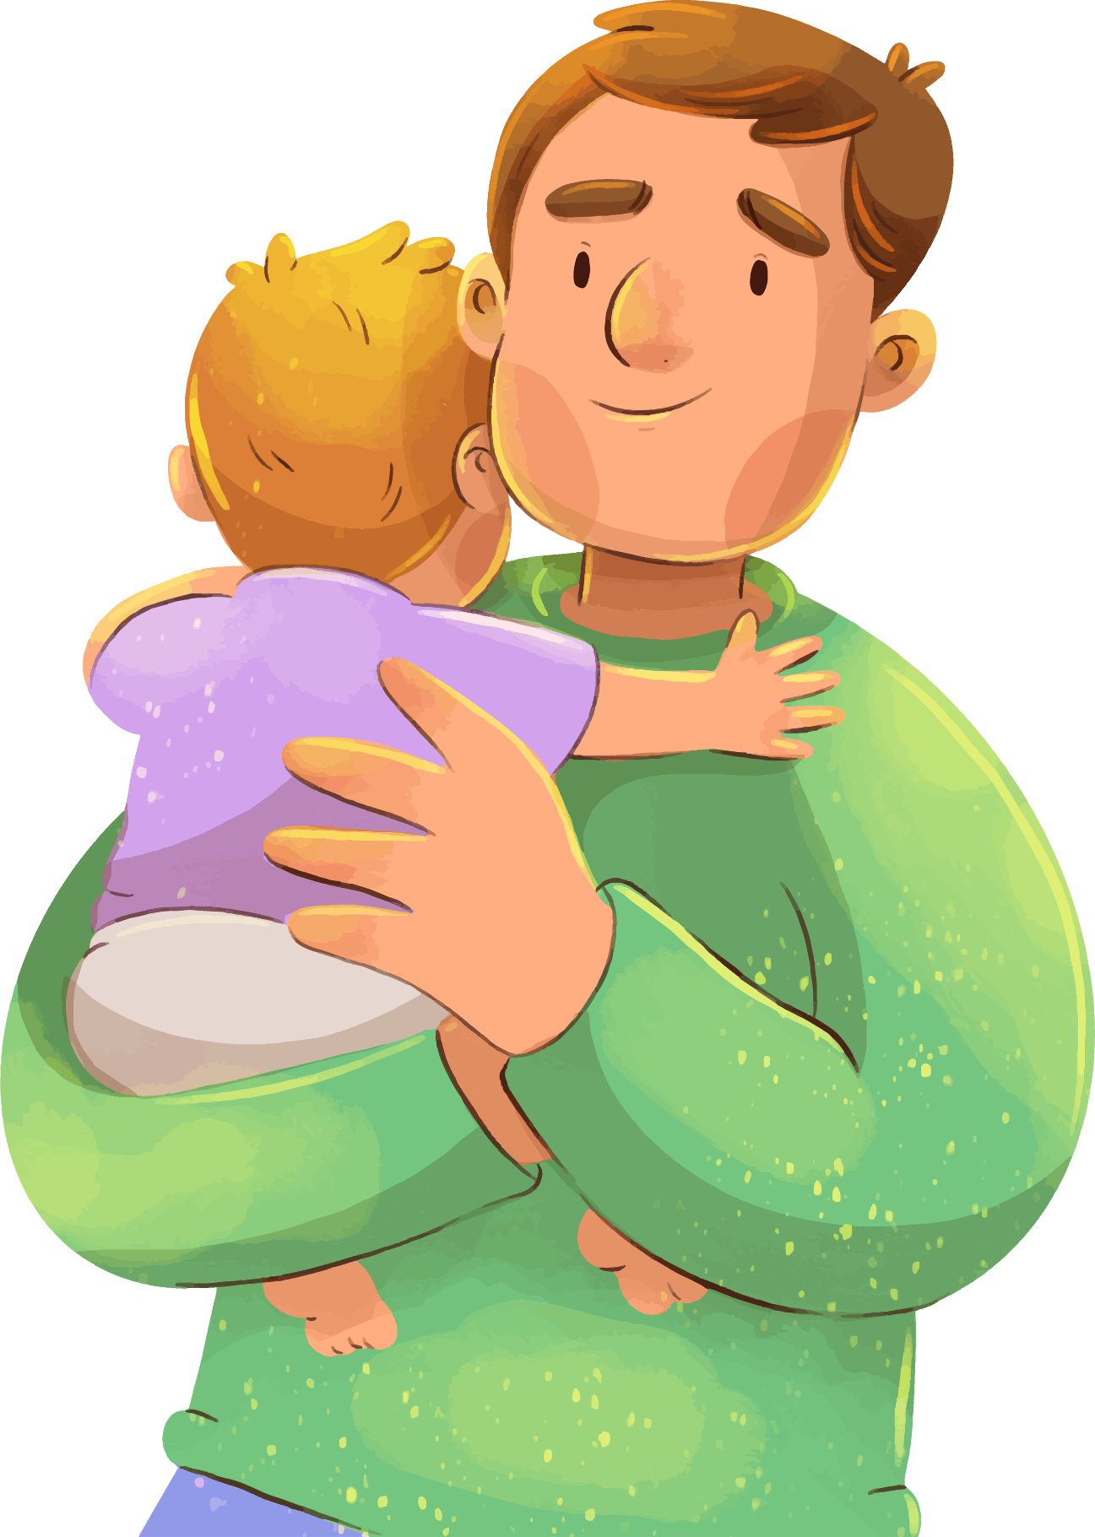
Happy
Fathers Day

Slide 2


Fonts used
Hello Father
https://www.1001fonts.com/hello-father-font.html
This presentation has been made using the following fonts:

Slide 3
“Dads are like chocolate chip cookies; they may have chips or be totally nutty, but they are sweet and make the world a better place, especially for their children.”

Slide 4

Table of content
01.
About
02.
Celebration
03.
Gifts Ideas
04.
Activities

Slide 5
02
About
Father's Day is a celebration celebrating people's fathers and celebrating fatherhood, paternal bonds, and the influence of fathers in society. It was first presented by Sonora Dodd of Spokane, Washington, in 1909. It is celebrated annually in the United States on the third Sunday in June.

Slide 6

Introduction
Father's Day is honored worldwide to recognize the grant that fathers and father figures make to their children's lives.

Slide 7
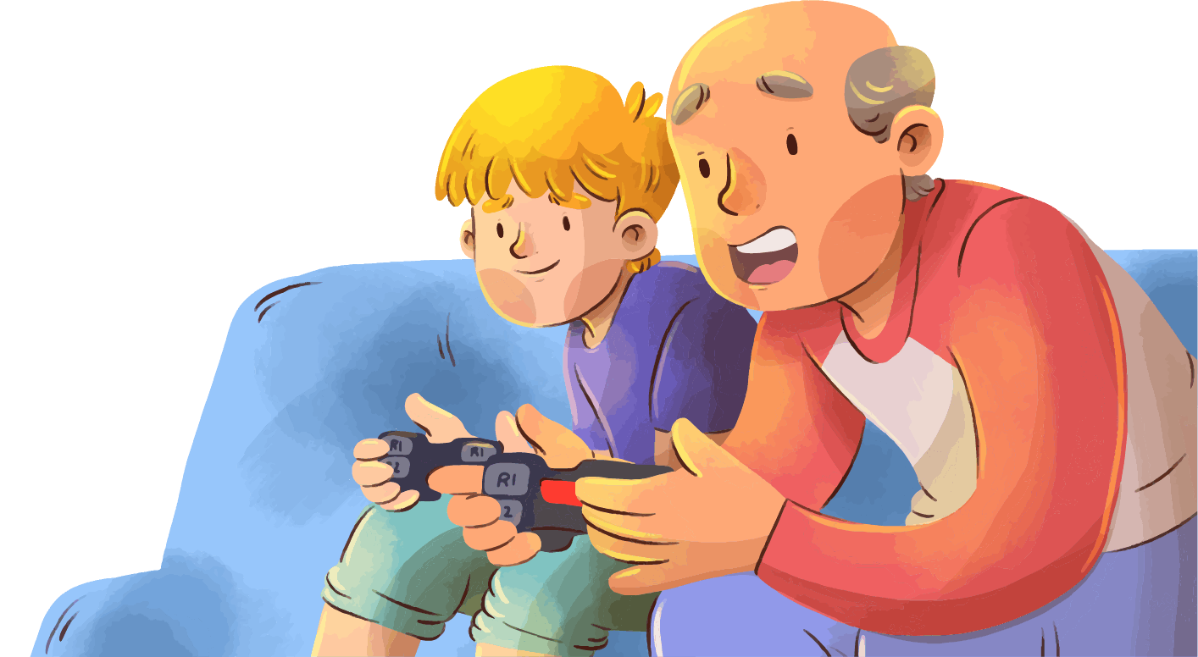
What is father’s day?
Father's Day is a holiday of celebrating fatherhood and paternal bonds, as well as the influence of fathers in society.

Slide 8
The five roles of a father
Here are 5 important but easily overlooked roles of a father
Motivator. As a dad, you are at times a helper, a coach, and a friend.
Enforcer. Fatherlessness is a great concern in our society today.
Encourager. Every child loves positive fatherly encouragement.
Trainer.
Counselor.

Slide 9
“You don’t have to deserve your mother’s love. You have to deserve your father’s. He’s more particular.”

Slide 10
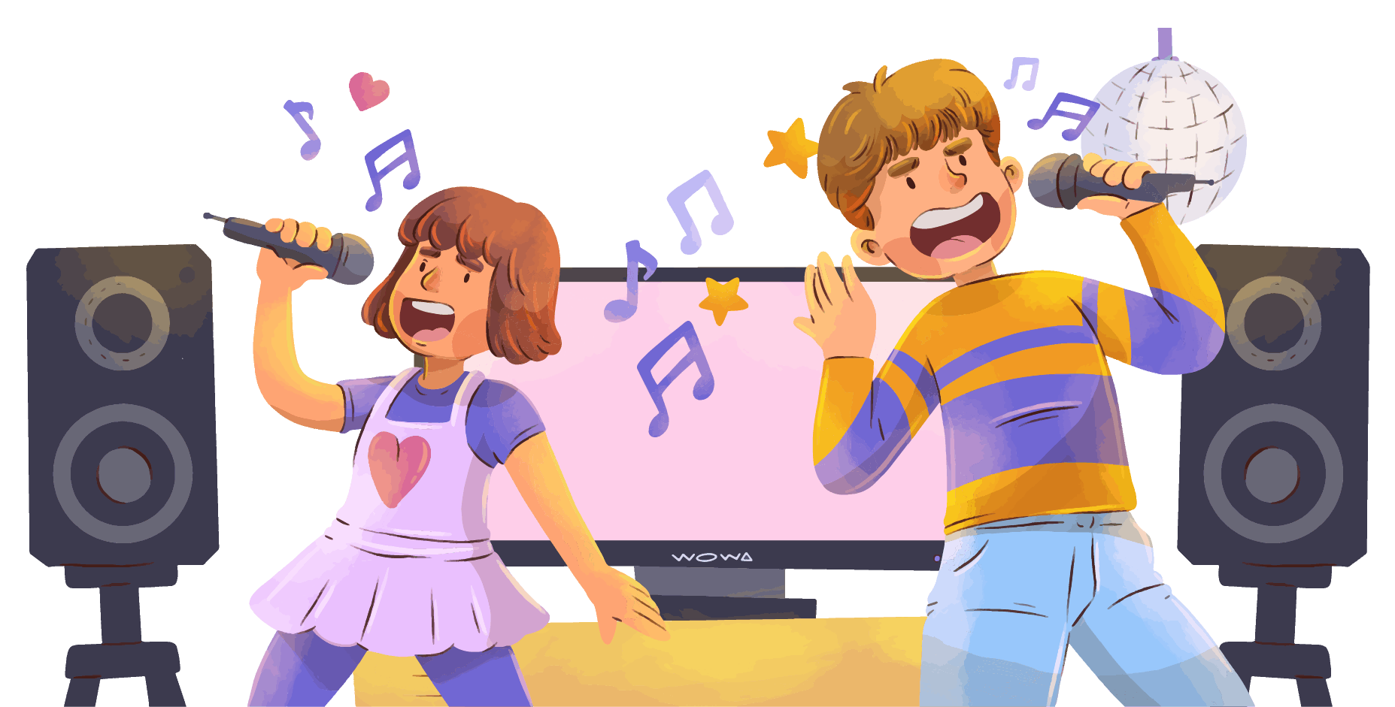
02
Celebration

Slide 11
Why is it celebrated?
Father’s Day, in the United States, is a holiday (the third Sunday in June) to honor fathers. Credit for initiating the holiday is usually given to Sonora Smart Dodd of Spokane, Washington, whose dad, a Civil War veteran, raised her and her five siblings after their mom died in childbirth. She is declared to have had the idea in 1909 while hearing a sermon on Mother’s Day, which was becoming specified as a holiday at the time. Local religious leaders supported the concept, and the first Father’s Day was honored on 19 June 1910, this month of the birthday of Dodd’s dad.

Slide 12


How to celebrate this day
Many people make a specific effort for their fathers or dad sculptures on Father's Day
Some people contact their fathers
While others give cards, flowers
Other gifts, such as clothing, sporting equipment
Luxury food items.

Slide 13






What to give on this day
Sport Gear
Home Decorate
Gadget
Clothing
Gift Card
Vehicles

Slide 14
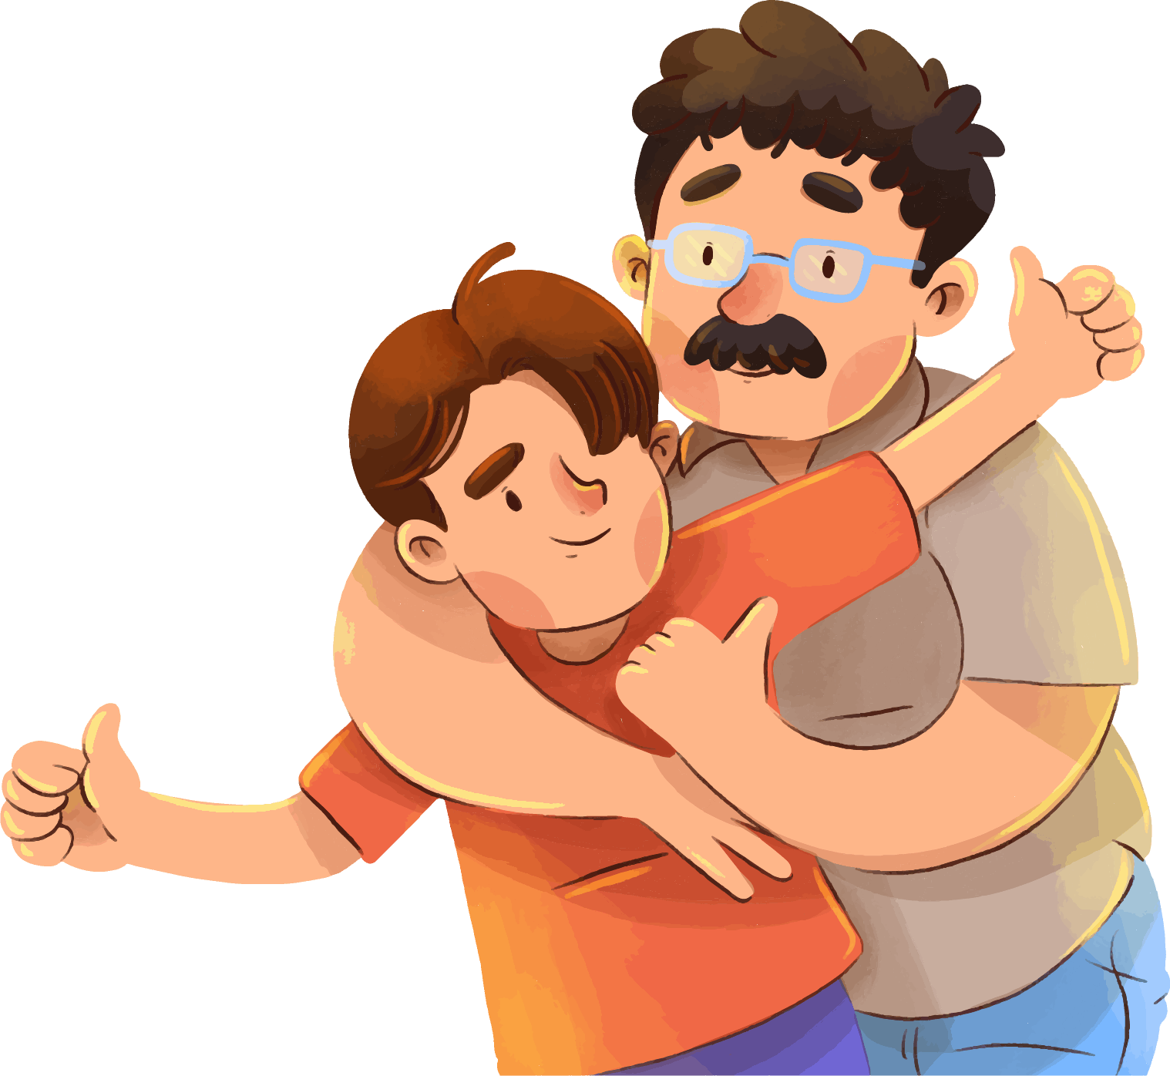
“A father’s words are like a thermostat that sets the temperature in the house.”

Slide 15
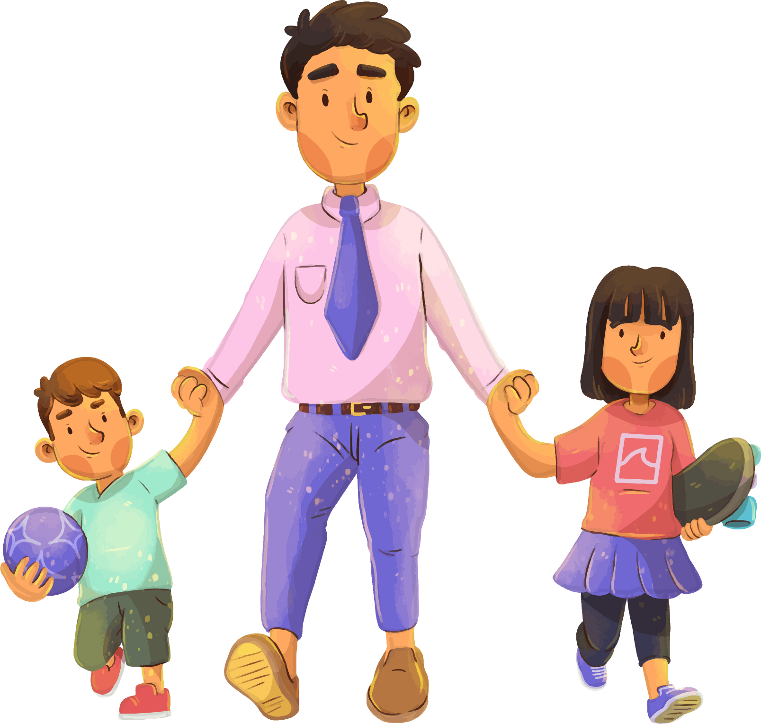
02
Memories

Slide 16




Memories with father

Slide 17
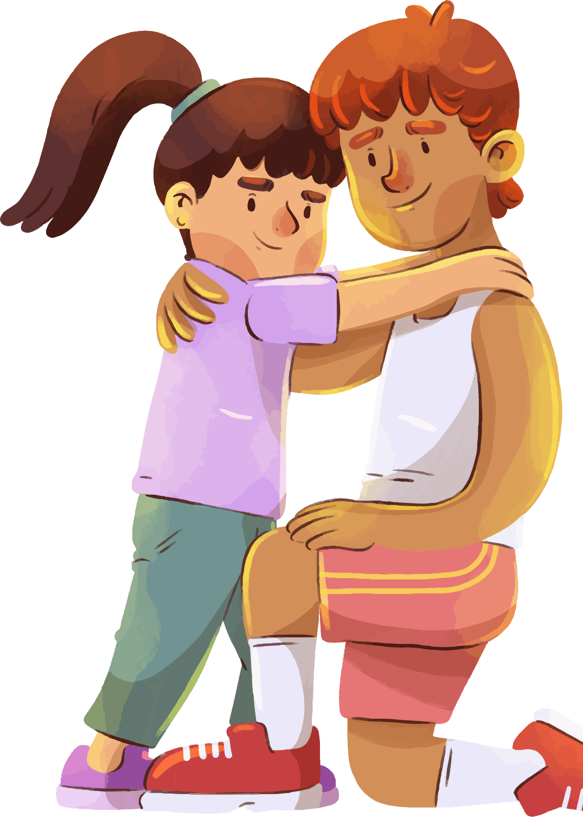
“A father’s words are like a thermostat that sets the temperature in the house.”

Slide 18
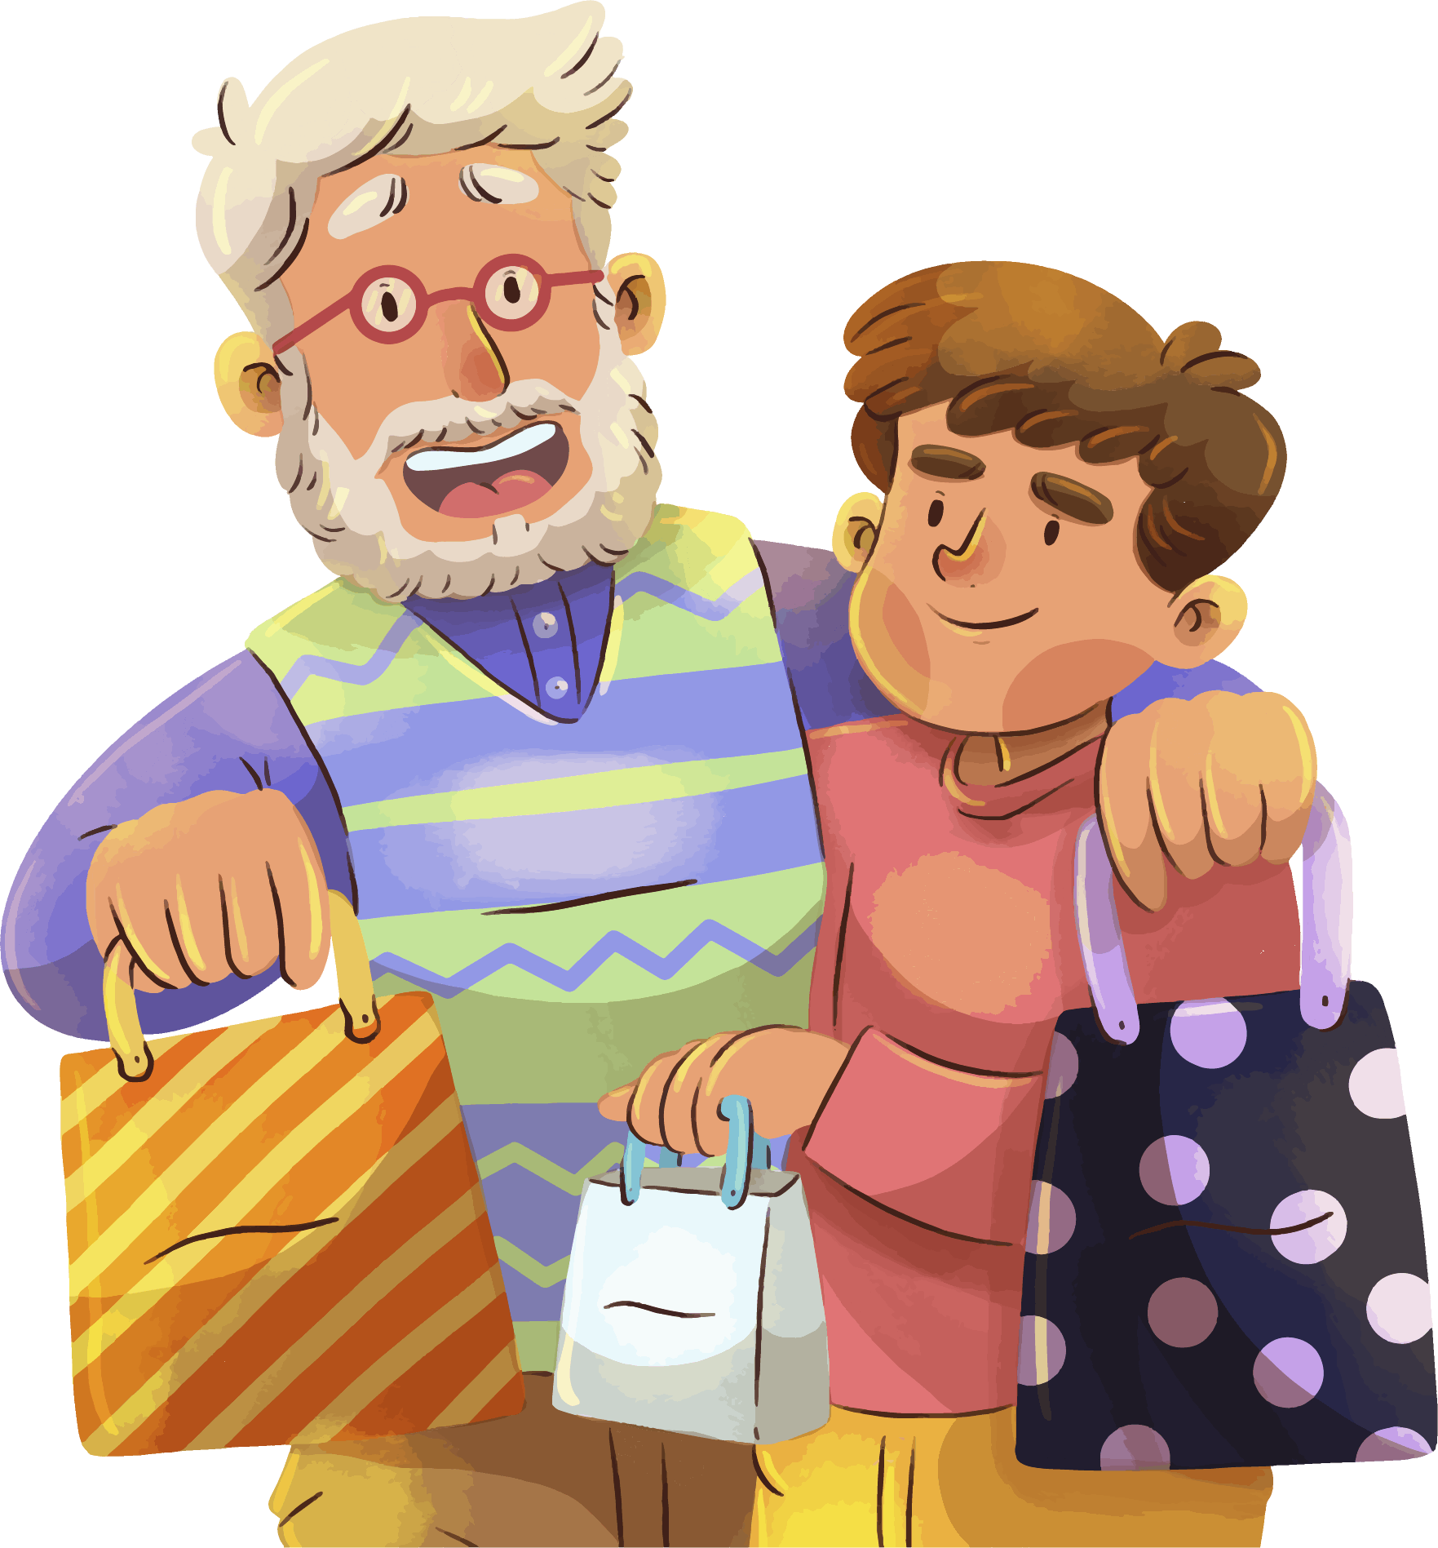
03
Gifts Ideas

Slide 19
Recipe for father's day
Coffee
Beer
Sweet

Slide 20



What is more, money spent on?
Gifts
Foods
Tour

Slide 21
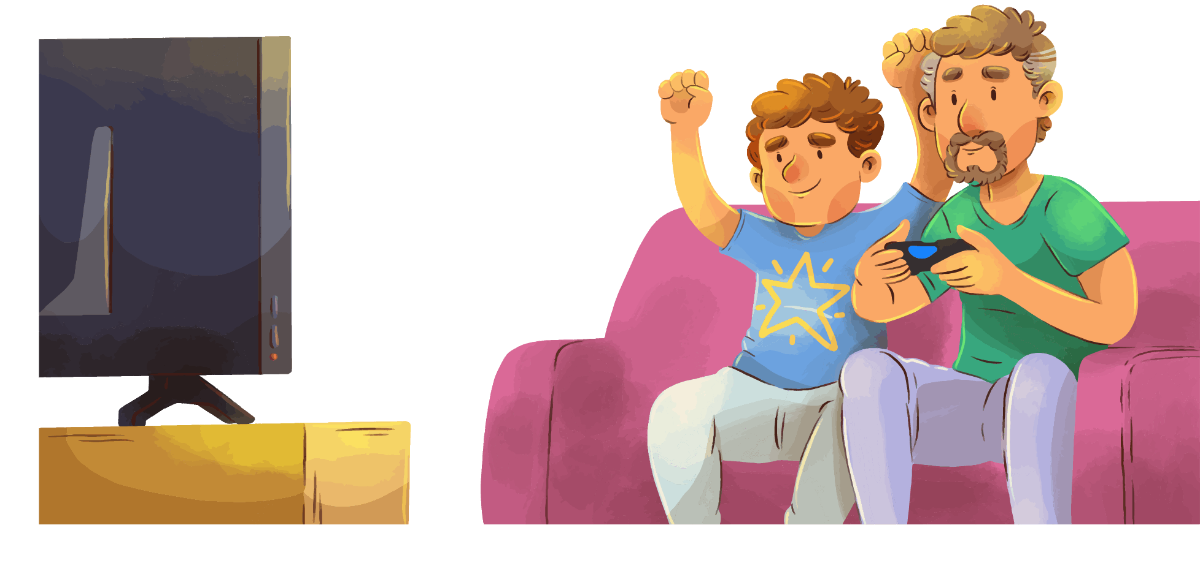
“A father’s words are like a thermostat that sets the temperature in the house.”

Slide 22


04
Activities

Slide 23



How do you congratulate
this day?
15%
65%
With a message
In Person
20%
By Phone

Slide 24
Distribution of activities
Cook
Play
25%
35%
Draw
To Learn
20%
30%

Slide 25


Things to do on the day
Activities | Where | Done
Activity 01 | Beach
Activity 02 | Mountain
Activity 03 | Party
Activity 04 | Bike Ride

Slide 26
Dates in other countries
March 19
Africa
March 19
Europe
September 4
Australia

Slide 27
Date in Spain
Mon | Tue | Wed | Thu | Fri | Sat | Sum
 | 1 | 2 | 3 | 4 | 5 | 6
7 | 8 | 9 | 10 | 11 | 12 | 13
14 | 15 | 16 | 17 | 18 | 19 | 20
21 | 22 | 23 | 24 | 25 | 26 | 27
28 | 29 | 30 | 31

Slide 28
“Dads are like chocolate chip cookies; they may have chips or be totally nutty, but they are sweet and make the world a better place, especially for their children.”

Slide 29
Father's day fun facts
1.5 Billion
Fathers worldwide
66.3 Billion
Father's are in the United States
100 Billion
Father's Day cards sent each year.

Slide 30
Father’s day quiz
What is father's love?
His love is sacrificial, patient, kind, humble, honest, forgiving, faithful, and selfless.
01
What is the story about father's day?
The first known Father's Day service appeared in Fairmont, West Virginia, on July 5, 1908, after hundreds of men passed in the worst mining casualty in U.S. history.
02

Slide 31


“You don’t have to deserve your mother’s love. You have to deserve your father’s. He’s more particular.”

Slide 32
Icons

Slide 33
Icons

Slide 34
How To Edit Shapes
You can add and edit some shapes to your presentation to present your data in a visual way.
Choose your favourite infographic and insert it in your presentation using Ctrl C + Ctrl V or Cmd C + Cmd V in Mac.
Select one of the parts and ungroup it by right-clicking and choosing “Ungroup”.
Change the color by clicking on the paint bucket.
Then resize the element by clicking and dragging one of the square-shaped points of its bounding box (the cursor should look like a double-headed arrow). Remember to hold Shift while dragging to keep the proportions.
Group the elements again by selecting them, right-clicking and choosing “Group”.
Repeat the steps above with the other parts and when you’re done editing, copy the end result and paste it into your presentation.
Remember to choose the “Keep source formatting” option so that it keeps the design. For more info, please visit iTalkedTech (Tips & Tricks).

Slide 35
Terms of Use (Free Users)
If you are a free subscriber, you should credit iTalkedTech by keeping the “Thank You” slide.
Kindly refer to the following slide for the Terms of Use for premium users.
You can:
Customize or edit this template
Use this template for both business and personal endeavors.
You can not:
Sell, rent, or second-license iTalkedTech content or its altered version.
Promulgate, unless explicitly permitted, iTalkedTech content, by iTalkedTech.
Incorporate iTalkedTech content in any database or file online or offline.
Obtain iTalkedTech content’s copyright.
Kindly refer to our Tutorial page or FAQ for advanced slide modification guidelines.

Slide 36
Terms of Use (Premium Users)
Being a premium subscriber, you have the privilege of using this PPT template
without giving attribution to iTalkedTech or keeping the “Thank You” slide.
You can:
Customize or edit this template.
Use this template for both business and personal endeavors.
Circulate or share the editable format of this template with anyone you want.
You can not:
Sell, rent or second-license iTalkedTech content or the altered version of it.
Promulgate or include the templates in any other services database
that performs as distribution or resale platform, unless explicitly permitted, by iTalkedTech.
Incorporate the elements used in iTalkedTech’s templates separately.
Obtain iTalkedTech’s copyright for the elements used in this template as a logo or trademark.
Kindly refer to our Tutorial page or FAQ for advanced slide modification guidelines.

Slide 37
Thank You!
We respect your valuable time with iTalkedTech!
If you have any questions, please reach us
Do you have a design request, please visit our redesign page.
CREDIT: iTalkedTech created this PowerPoint template.
Let this slide be kept for attribution.
www.iTalkedTech.com

