Slide 1

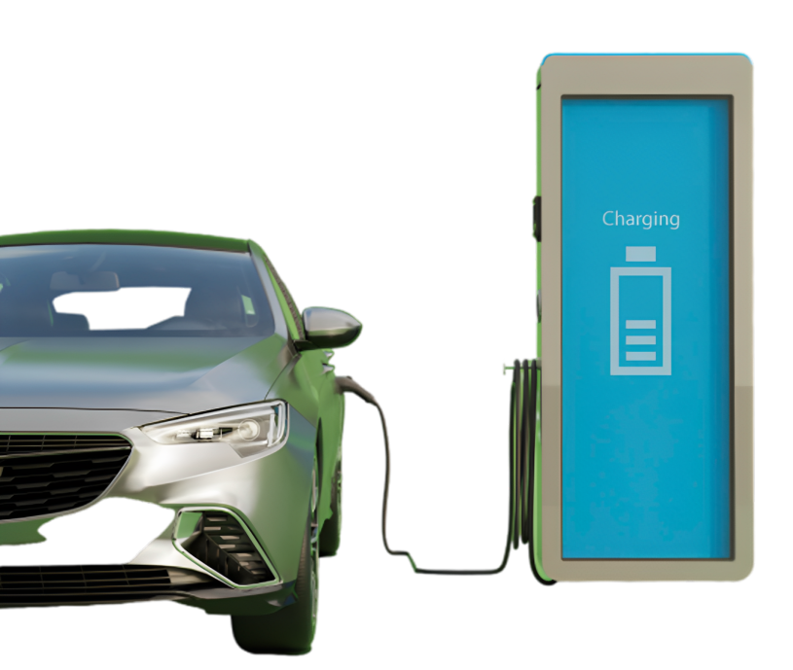
Electric Car Presentation
ELECTRIC CAR
The electric car is not just a new type of vehicle; it is a catalyst for positive change, paving the way for a greener and more sustainable future.

Slide 2
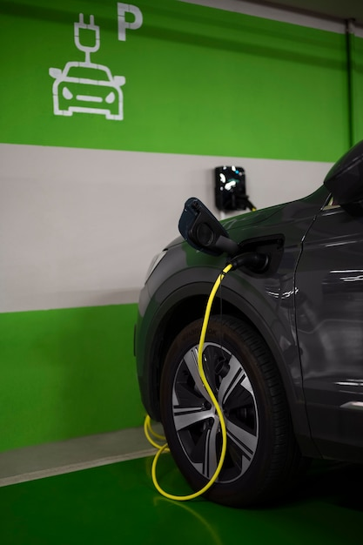

Electric Car Presentation
Environmental Impact
Electric cars offer a sustainable transportation solution, producing zero tailpipe emissions, reducing air pollution, and mitigating the impact of climate change.

Slide 3
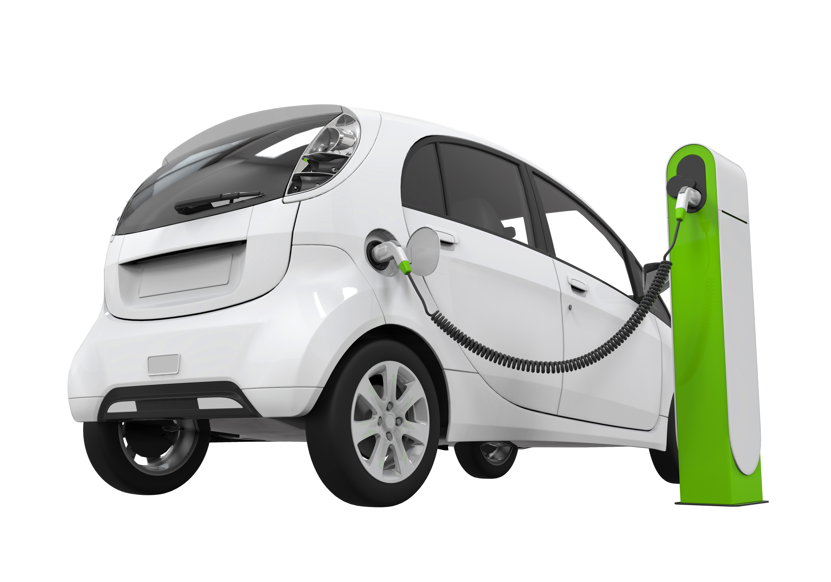
Electric Car Presentation
Range And Charging Infrastructure
Exploring the advancements in electric vehicle technology, including improved range capabilities and the growing network of charging stations, making electric cars more practical and convenient.

Slide 4
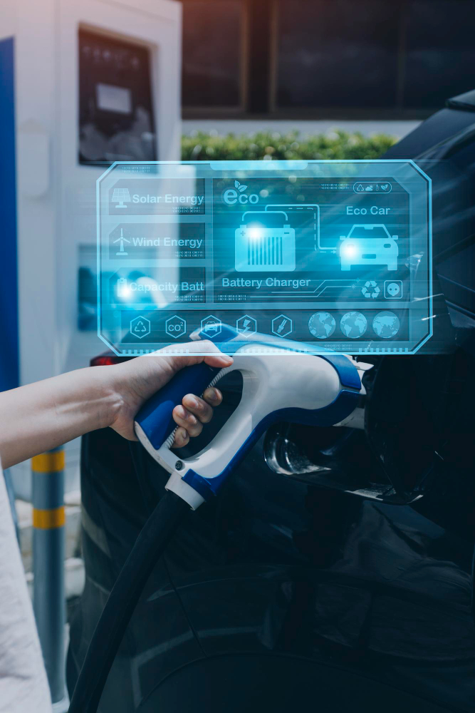
Electric Car Presentation
Cost Savings
Electric cars offer long-term cost savings through reduced fuel expenses and lower maintenance requirements, contributing to a more economical and sustainable transportation option.

Slide 5

Electric Car Presentation
Driving Experience And Performance
Electric cars provide instant torque, smooth acceleration, and a quiet driving experience, showcasing their technological advancements and proving that sustainability doesn't compromise performance.

Slide 6
Icons

Slide 7
Icons

Slide 8
How To Edit Shapes
You can add and edit some shapes to your presentation to present your data in a visual way.
Choose your favourite infographic and insert it in your presentation using Ctrl C + Ctrl V or Cmd C + Cmd V in Mac.
Select one of the parts and ungroup it by right-clicking and choosing “Ungroup”.
Change the color by clicking on the paint bucket.
Then resize the element by clicking and dragging one of the square-shaped points of its bounding box (the cursor should look like a double-headed arrow). Remember to hold Shift while dragging to keep the proportions.
Group the elements again by selecting them, right-clicking and choosing “Group”.
Repeat the steps above with the other parts and when you’re done editing, copy the end result and paste it into your presentation.
Remember to choose the “Keep source formatting” option so that it keeps the design. For more info, please visit iTalkedtech (Tips & Tricks).

Slide 9
Terms Of Use (Free Users)
If you are a free subscriber, you should credit iTalkedtech by keeping the “Thank You” slide.
Kindly refer to the following slide for the Terms of Use for premium users.
You can:
Customize or edit this template
Use this template for both business and personal endeavors.
You can not:
Sell, rent, or second-license iTalkedtech content or its altered version.
Promulgate, unless explicitly permitted, iTalkedtech content, by iTalkedtech.
Incorporate iTalkedtech content in any database or file online or offline.
Obtain iTalkedtech content’s copyright.
Kindly refer to our Tutorial page or FAQ for advanced slide modification guidelines.

Slide 10
Terms Of Use (Premium Users)
Being a premium subscriber, you have the privilege of using this PPT template
without giving attribution to iTalkedtech or keeping the “Thank You” slide.
You can:
Customize or edit this template.
Use this template for both business and personal endeavors.
Circulate or share the editable format of this template with anyone you want.
You can not:
Sell, rent or second-license iTalkedtech content or the altered version of it.
Promulgate or include the templates in any other services database
that performs as distribution or resale platform, unless explicitly permitted, by iTalkedtech.
Incorporate the elements used in iTalkedtech’s templates separately.
Obtain iTalkedtech’s copyright for the elements used in this template as a logo or trademark.
Kindly refer to our Tutorial page or FAQ for advanced slide modification guidelines.

Slide 11





Thank You!
We respect your valuable time with italkedtech!
If you have any questions, please reach us
,
Do you have a design request, please visit our redesign page.
CREDIT: italkedtech created this PowerPoint template.
Let this slide be kept for attribution.
www.italkedtech.com

