Slide 1
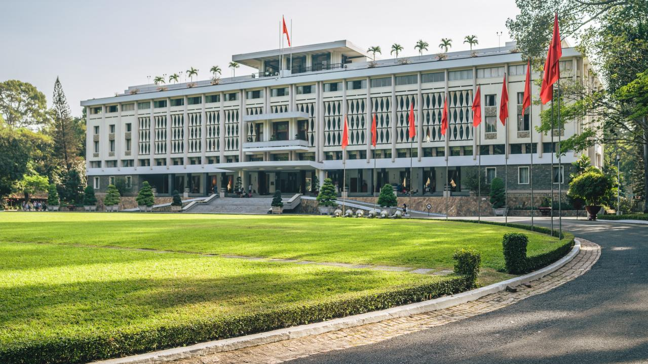

School Name
SCHOOL
Presentation

Slide 2

Definition of School
A school is an educational institution where students learn a variety of subjects and skills that are necessary for their personal and professional growth.

Slide 3

Types of Schools
There are various types of schools, including public, private, charter, and homeschooling. Each type of school has its own set of benefits and drawbacks.

Slide 4

School Organization
Schools are usually organized into grade levels or years, and each grade level or year has its own set of courses and requirements. Schools are also organized into departments, which are responsible for teaching specific subjects.

Slide 5

The curriculum taught in schools usually includes core subjects such as English, math, science, and social studies, as well as elective courses that allow students to explore their interests.
Curriculum

Slide 6

Teaching Methods
Schools use a variety of teaching methods, including lectures, group work, hands-on projects, and online learning, to engage students and facilitate learning.

Slide 7


Assessment and Evaluation
Schools assess and evaluate student performance through various methods, such as tests, quizzes, projects, and other forms of assessment, to ensure that students are meeting academic standards.

Slide 8


School Culture
School culture encompasses the shared beliefs, values, and traditions of a school community, including the relationships between students, teachers, and administrators.

Slide 9

Student Life
Student life includes extracurricular activities, clubs, sports, and social events that take place outside of the classroom.

Slide 10

School Safety
Schools have policies and procedures in place to ensure the safety and security of students and staff, including emergency preparedness plans and security measures.

Slide 11

Special Education
Schools provide special education services to students with disabilities to ensure that they have equal access to education.

Slide 12

School Discipline
Schools have disciplinary policies and procedures in place to ensure that students follow the rules and receive appropriate consequences for their actions.

Slide 13


Technology in Schools
Schools use technology, such as computers, tablets, and other devices, to enhance learning and improve communication between students, teachers, and parents.

Slide 14

Parental Involvement
Parents are encouraged to be involved in their child's education, including attending parent-teacher conferences and volunteering at the school.

Slide 15

School Funding
Schools receive funding from various sources, such as the government, private donations, and tuition fees, which can impact the quality of education that they are able to provide.

Slide 16


School Improvement
Schools are always seeking to improve their programs and services, and may engage in initiatives such as professional development for teachers, implementing new technologies, or improving infrastructure.

Slide 17
Icons

Slide 18
Icons

Slide 19
How To Edit Shapes
You can add and edit some shapes to your presentation to present your data in a visual way.
Choose your favourite infographic and insert it in your presentation using Ctrl C + Ctrl V or Cmd C + Cmd V in Mac.
Select one of the parts and ungroup it by right-clicking and choosing “Ungroup”.
Change the color by clicking on the paint bucket.
Then resize the element by clicking and dragging one of the square-shaped points of its bounding box (the cursor should look like a double-headed arrow). Remember to hold Shift while dragging to keep the proportions.
Group the elements again by selecting them, right-clicking and choosing “Group”.
Repeat the steps above with the other parts and when you’re done editing, copy the end result and paste it into your presentation.
Remember to choose the “Keep source formatting” option so that it keeps the design. For more info, please visit italkedtech (Tips & Tricks).

Slide 20
Terms Of Use (Free Users)
If you are a free subscriber, you should credit italkedtech by keeping the “Thank You” slide.
Kindly refer to the following slide for the Terms of Use for premium users.
You can:
Customize or edit this template
Use this template for both business and personal endeavors.
You can not:
Sell, rent, or second-license italkedtech content or its altered version.
Promulgate, unless explicitly permitted, italkedtech content, by italkedtech.
Incorporate italkedtech content in any database or file online or offline.
Obtain italkedtech content’s copyright.
Kindly refer to our Tutorial page or FAQ for advanced slide modification guidelines.

Slide 21
Terms Of Use (Premium Users)
Being a premium subscriber, you have the privilege of using this PPT template
without giving attribution to italkedtech or keeping the “Thank You” slide.
You can:
Customize or edit this template.
Use this template for both business and personal endeavors.
Circulate or share the editable format of this template with anyone you want.
You can not:
Sell, rent or second-license italkedtech content or the altered version of it.
Promulgate or include the templates in any other services database
that performs as distribution or resale platform, unless explicitly permitted, by italkedtech.
Incorporate the elements used in italkedtech’s templates separately.
Obtain italkedtech’s copyright for the elements used in this template as a logo or trademark.
Kindly refer to our Tutorial page or FAQ for advanced slide modification guidelines.

Slide 22





Thank You!
We respect your valuable time with italkedtech!
If you have any questions, please reach us
,
Do you have a design request, please visit our redesign page.
CREDIT: italkedtech created this PowerPoint template.
Let this slide be kept for attribution.
www.italkedtech.com

