Slide 1
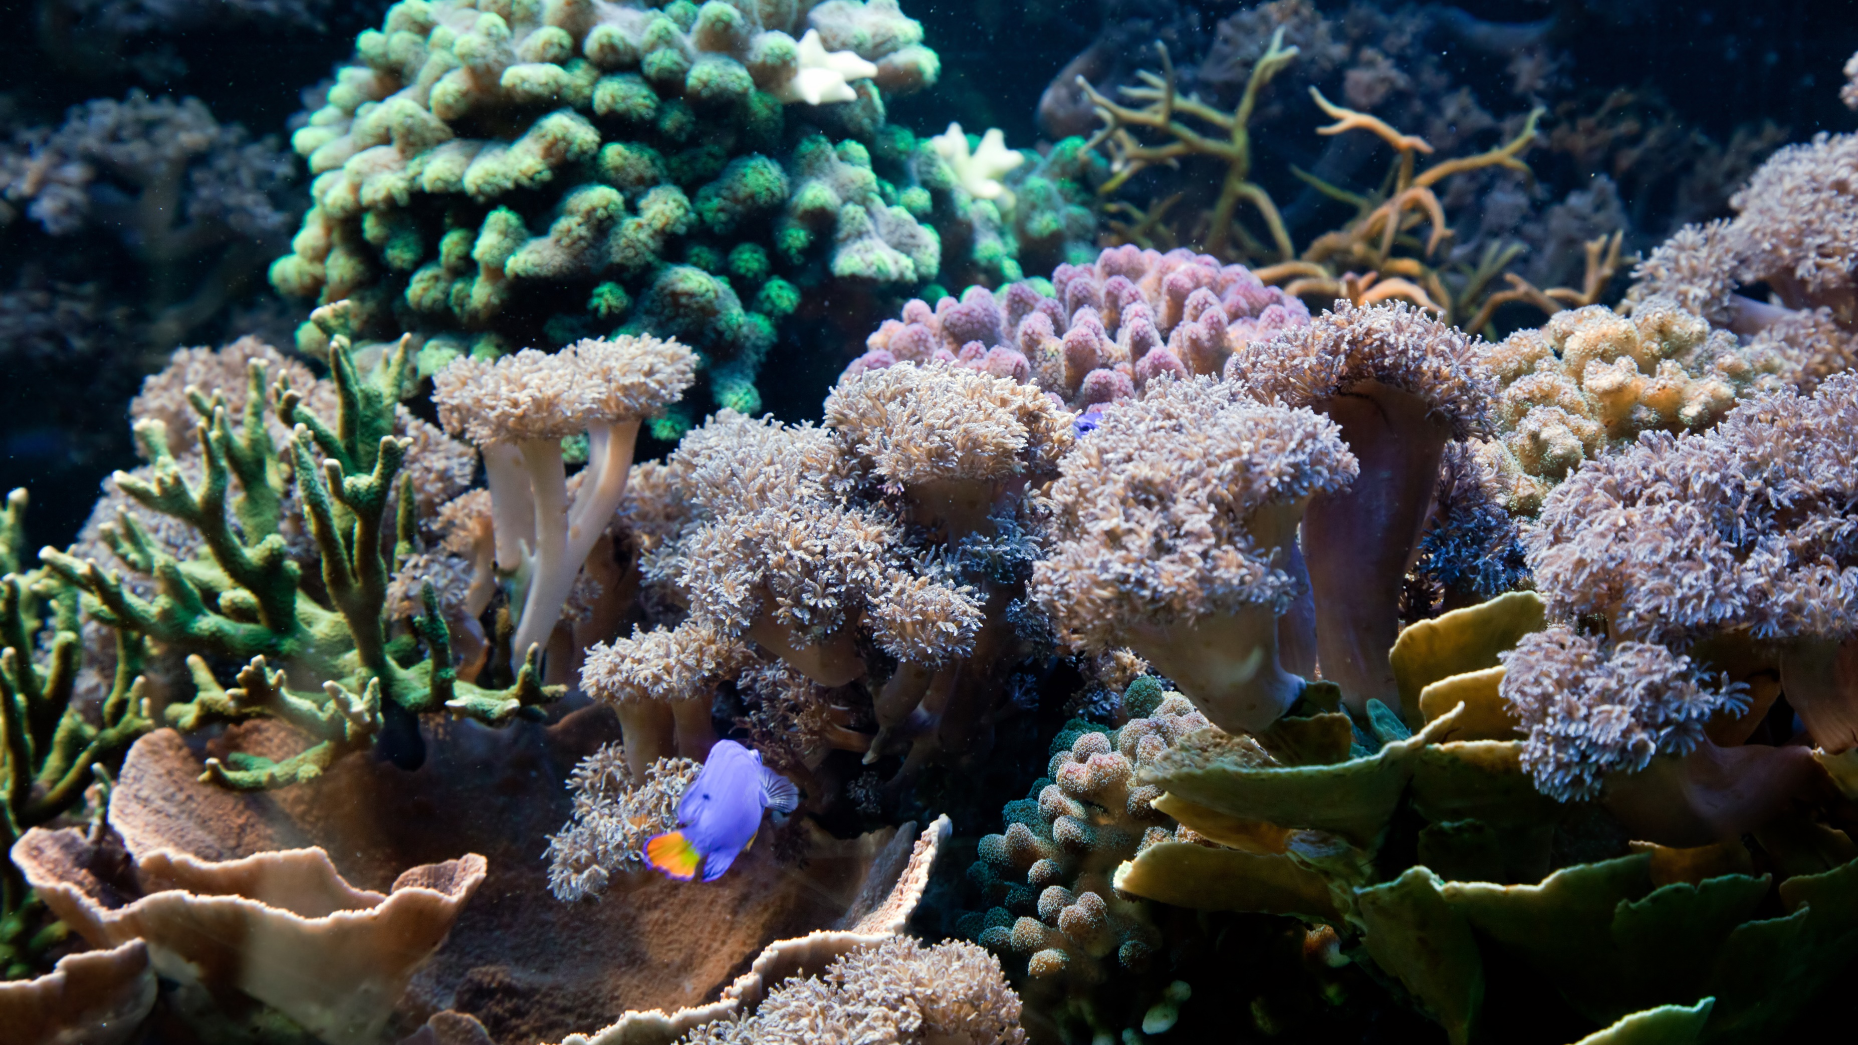
World Reef Awareness Day
June 1
Annual event raising awareness about the importance and conservation of reefs.

Slide 2
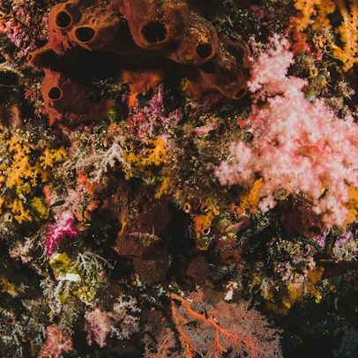

Introduction
Join us on World Reef Awareness Day, a global initiative aimed at fostering awareness and appreciation for the incredible beauty, biodiversity, and ecological significance of coral reefs, while highlighting the urgent need for their protection.

Slide 3
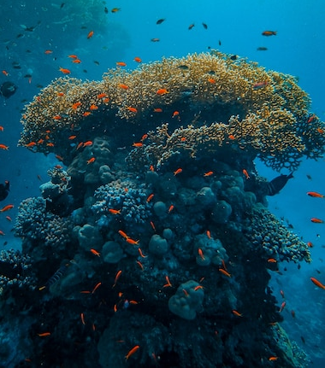

History
World Reef Awareness Day was established to address the escalating threats to coral reefs. First observed in [year], it has grown into a global movement uniting organizations and individuals to raise awareness, promote conservation efforts, and advocate for reef preservation worldwide.

Slide 4
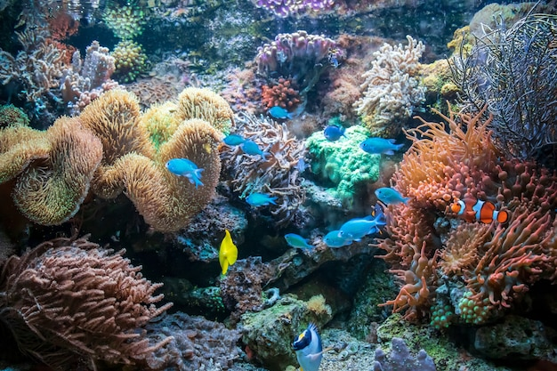
Timeline
1770
James Cook Finds the Great Barrier Reef
1928–1929
The Great Reef Expedition Gives Valuable Insights
1980
Coral Reefs Start Bleaching
Reef
Awareness
2016
The Great Barrier Reef is Destroyed

Slide 5
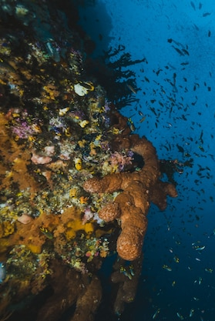
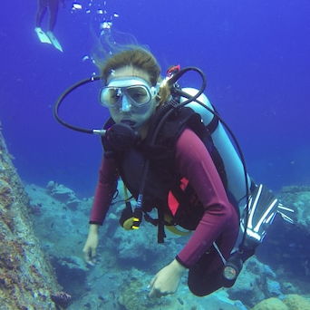
Why Celebrated World Reef Awareness Day
World Reef Awareness Day is celebrated to highlight the critical importance of coral reefs and their fragile ecosystems. It aims to increase public understanding, engage communities, and mobilize action to protect and preserve reefs, combating the threats of climate change, pollution, and overfishing.

Slide 6
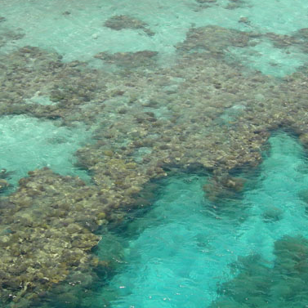
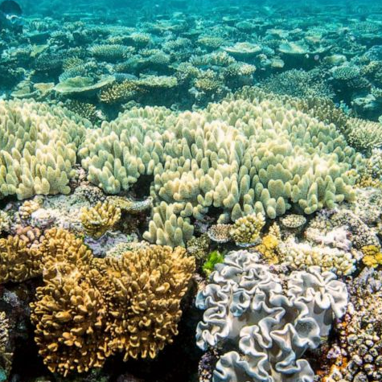
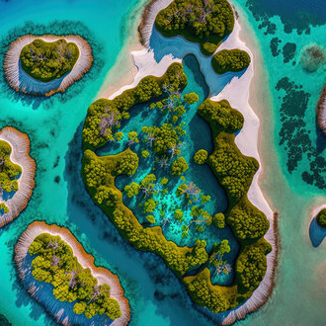
Types Of Reef
Fringing Reef
Barrier Reef
Atoll

Slide 7
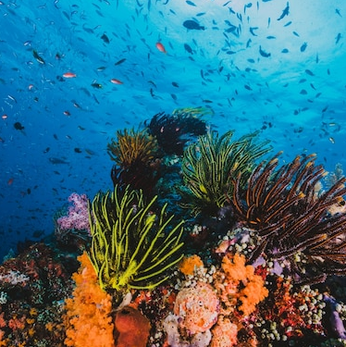
Importance Of Coral Reefs
Highlighting the ecological significance of coral reefs and their role in supporting marine biodiversity and coastal communities.
01
Coral Reef Ecosystems and Biodiversity
02
Coral Reefs as Natural Barriers and Coastal Protection
03
Economic Value of Coral Reefs for Tourism and Fisheries

Slide 8
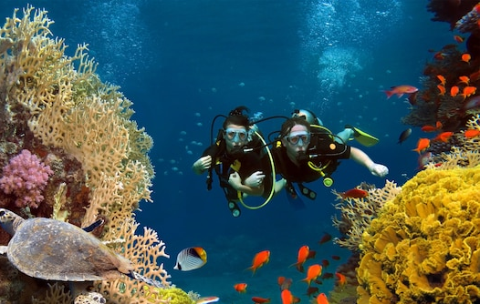
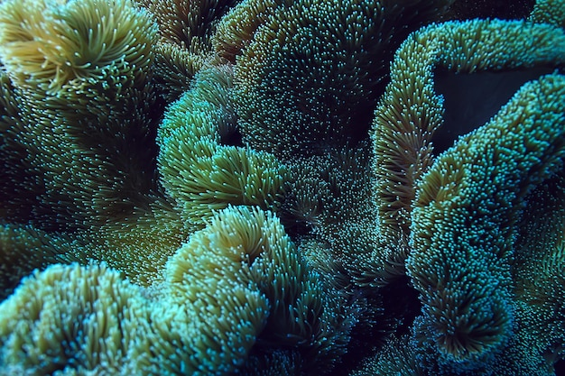
Threats To Coral Reefs
Threats to coral reefs encompass a range of factors that jeopardize their health and survival, including climate change, ocean acidification, pollution, overfishing, destructive fishing practices, coral bleaching, and habitat destruction.

Slide 9
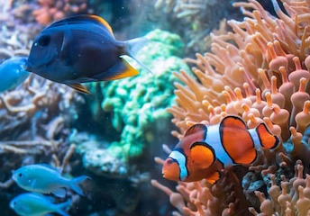
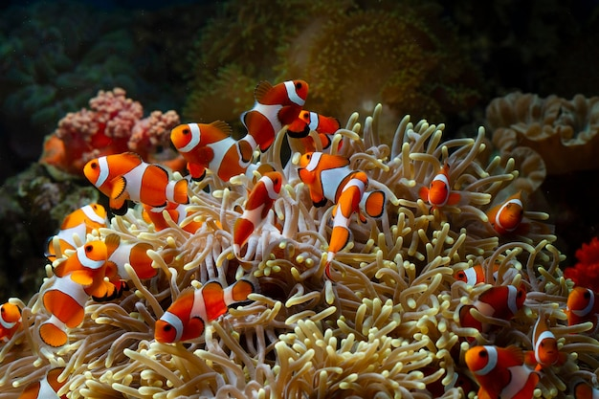
Conservation And Restoration Efforts
Showcasing initiatives and projects aimed at protecting and restoring coral reefs, including coral gardening, marine reserves, and sustainable practices.
01
Coral Reef Restoration Techniques
02
Marine Protected Areas and Reef Conservation
03
Community-Based Reef Management

Slide 10

Sustainable Reef Tourism
Sustainable reef tourism refers to responsible and environmentally conscious practices in visiting and experiencing coral reef ecosystems. It aims to minimize negative impacts, promote conservation, support local communities, and ensure long-term viability of reefs for future generations.

Slide 11
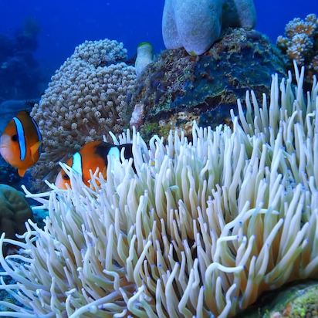
Coral Reef Education And Awareness
Promoting public awareness and education about coral reefs, their importance, and the actions individuals can take to protect them.
Reef Awareness Campaigns and Events
School Programs and Curricula
Citizen Science and Volunteer Opportunities

Slide 12
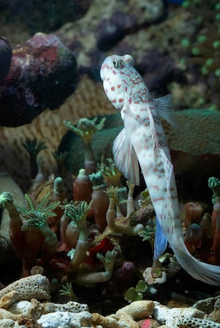
Climate Change And Coral Reefs
Examining the impact of climate change on coral reefs, including strategies to mitigate climate-related threats and enhance reef resilience.
1
Coral Adaptation and Resilience to Climate Change
2
Mitigating Reef Stressors and Climate Impacts

Slide 13
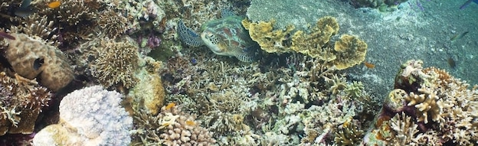
Mitigating Reef Stressors And Climate Impacts
Over 25% of sea life
Over 25% of sea life that rely upon coral reefs may lose their habitat. Coral reefs are a source of food and shelter for the survival of such marine species.

Slide 14
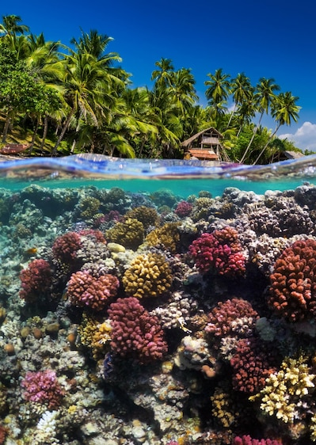
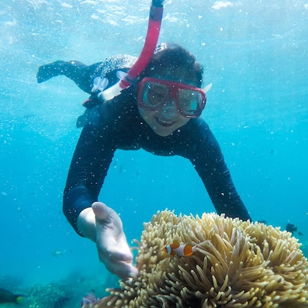
Dates Of This Day
Year
Date
Day
2023 | June 1 | Thursday
2024 | June 1 | Saturday
2025 | June 1 | Sunday
2026 | June 1 | Monday
2027 | June 1 | Tuesday

Slide 15
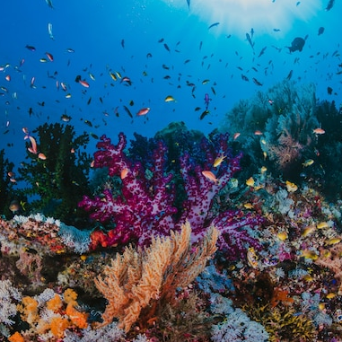
Conclusion
In conclusion, World Reef Awareness Day is a powerful global initiative that educates, engages, and inspires individuals to protect and conserve coral reefs, vital ecosystems teeming with biodiversity, for a sustainable and resilient future.

Slide 16
Icons

Slide 17
Icons

Slide 18
How To Edit Shapes
You can add and edit some shapes to your presentation to present your data in a visual way.
Choose your favourite infographic and insert it in your presentation using Ctrl C + Ctrl V or Cmd C + Cmd V in Mac.
Select one of the parts and ungroup it by right-clicking and choosing “Ungroup”.
Change the color by clicking on the paint bucket.
Then resize the element by clicking and dragging one of the square-shaped points of its bounding box (the cursor should look like a double-headed arrow). Remember to hold Shift while dragging to keep the proportions.
Group the elements again by selecting them, right-clicking and choosing “Group”.
Repeat the steps above with the other parts and when you’re done editing, copy the end result and paste it into your presentation.
Remember to choose the “Keep source formatting” option so that it keeps the design. For more info, please visit Slideegg (Tips & Tricks).

Slide 19
Terms Of Use (Free Users)
If you are a free subscriber, you should credit SlideEgg by keeping the “Thank You” slide.
Kindly refer to the following slide for the Terms of Use for premium users.
You can:
Customize or edit this template
Use this template for both business and personal endeavors.
You can not:
Sell, rent, or second-license SlideEgg content or its altered version.
Promulgate, unless explicitly permitted, SlideEgg content, by SlideEgg.
Incorporate SlideEgg content in any database or file online or offline.
Obtain SlideEgg content’s copyright.
Kindly refer to our Tutorial page or FAQ for advanced slide modification guidelines.

Slide 20
Terms Of Use (Premium Users)
Being a premium subscriber, you have the privilege of using this PPT template
without giving attribution to SlideEgg or keeping the “Thank You” slide.
You can:
Customize or edit this template.
Use this template for both business and personal endeavors.
Circulate or share the editable format of this template with anyone you want.
You can not:
Sell, rent or second-license SlideEgg content or the altered version of it.
Promulgate or include the templates in any other services database
that performs as distribution or resale platform, unless explicitly permitted, by SlideEgg.
Incorporate the elements used in SlideEgg’s templates separately.
Obtain SlideEgg’s copyright for the elements used in this template as a logo or trademark.
Kindly refer to our Tutorial page or FAQ for advanced slide modification guidelines.

Slide 21
Thank You!
We respect your valuable time with SlideEgg!
If you have any questions, please reach us
Do you have a design request, please visit our redesign page.
CREDIT: iTalkedtech created this PowerPoint template.
Let this slide be kept for attribution.
www.slideegg.com

